Slide 1
Balkan Romani Music: Issues of Appropriation And Representation
Cultural exchange
Appreciation vs. Appropriation
“Power imbalance
Harmful, mocking
Used without consent
Commodification, profit”
But consider context: hybridity

Slide 2
Gypsy Halloween Costumes
https://www.orientaltrading.com/womens-fortune-teller-gypsy-costume-a2-14290794.fltr?csku=IC1051LG&plaId=555614
$185

Slide 3
Esmeralda, Disney’s Hunchback of Notre Dame

Slide 4
Cultural Appropriation: Fashion, food, magic, music

Slide 5
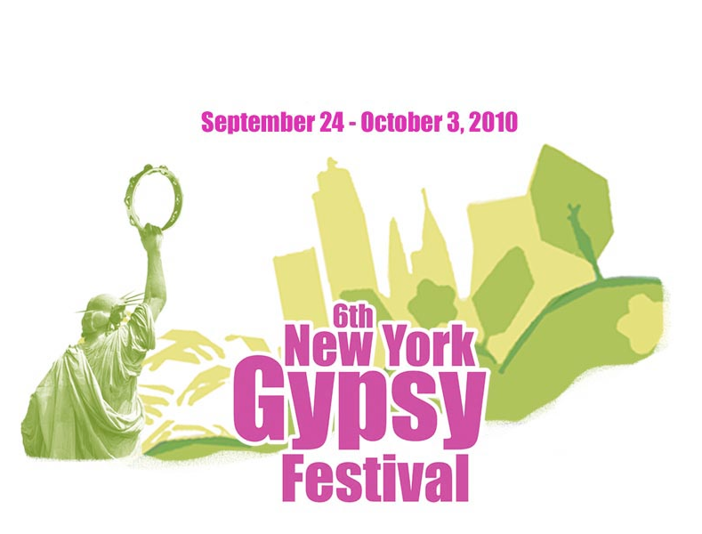

Slide 7
Protest by Roma and Allies

Slide 10
Goran Bregović, Guča Brass Band Festival, Serbia, 2010
1990s Popularity of Brass Band Music
Emir Kusturtica’s films: Underground, Time of the Gypsies

Slide 11
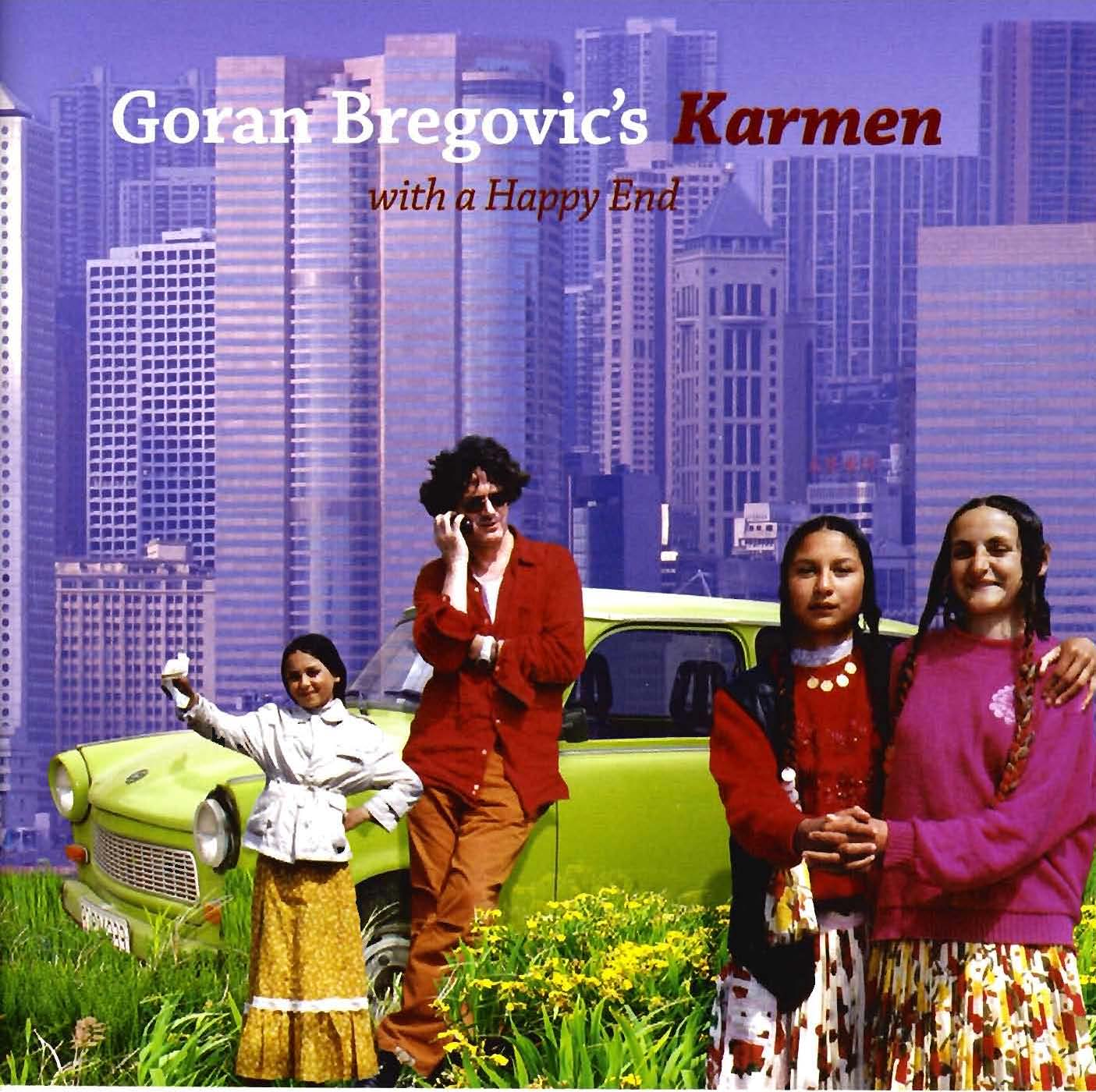

Slide 12
Wedding and funeral band

Slide 14
Marko i Boban Marković Ork. (Serbia) vs. Fanfare Ciocarlia (Romania)
Balkan Brass Battle 2011

