Slide 1
Politics, Activism, and Romani Music in Serbia, North Macedonia and Bulgaria
Long history of Balkan Romani musicians as professionals: often as intercultural brokers. Embedded in unequal economic contexts and hierarchies of power
Centuries of discrimination; slavery in Romania 1360s-1860s; Nazi genocide
Today: alarming rates of xenophobia, prejudice, and violence; poverty; violence
Musicians often have higher class status– often “pass” as non-Roma
The combination of musical resilience with adaptive strategy is notable.
For hundreds of years, music has remained a viable profession despite the myriad challenges that Roma face.
Roma have adapted and covertly resisted their oppression rather than openly rebelled. But huge mobilization since 1989.
Roma rarely write “protest songs” but song texts refence poverty and gender oppression
What is novel about recent activist music?
Intersection with LGBTQ activism re: Azis

Slide 2
How can music and activism can be successfully combined?
Reject narrow formula as “protest song”
Surviving is activism; celebrating is resistance
Activism may be declaring one’s Romani identity musically in non-stereotypical ways; resisting exploitation of non-Romani producers; producing/managing your own career
Wedding work still in Romani hands, but wedding music tend not to be “globalized commercially” for non-Romani markets
When “Gypsy” music becomes a market commodity, festivals, concerts, and albums are often produced by non-Roma
Questions of representation
Who benefits from the popularization of “Gypsy” music?

Slide 3
Recent activist music projects 2020-
Address political issues facing Balkan Roma such as prejudice, unemployment, police brutality, evictions, and also gender discrimination.
What forms do these projects take? Who produces them and why?
What are the gendered dimensions of activism?
What effect do they have?
Trends:
Top-down, often sponsored by non-governmental organizations, NGOs
Or grassroots activism
Complicate this binary
Plus celebrity activism, e.g., Azis

Slide 4

Historical Music Activism
Romani Anthem: Dželem Dželem
text by Žarko Jovanović
Balkan melody
London Romani Congress, 1971
https://www.romarchive.eu/en/music/romani-anthem-microcosm-diversity/
https://www.academia.edu/26976956/Studii_Romani_2
Romani flag adopted
International Roma Day April 8th

Slide 5
Recorded text by Rromano Dives:
I’ve traveled, I’ve traveled on long roads Gelem, gelem lungone dromenca
I’ve met Roma of good fortune Maladilem bahtale Romenca
Oh, Roma, where have you come from A, Romale, khatar tumen aven
With your tents and your hungry children? Le carhenca, bokhale čhavenca?
Chorus: Oh, Roma, oh, people! A, Romale, a, čhavale!
I, too, once had a large family Vi man sasa bari famelia
The [Nazi] Black Legion slaughtered them Murdarda len i Kali legia
They were all murdered, the women along with the men Saren čhinde, vi romen vi romnian
And the little children among them Maškar lende vi cikne čhavoren
Open, oh Lord, your black gates Phutar, Devla, te kale vudara
And let me see where my people are Te šaj dikhav kaj si me manuša
So that I can travel once again on long roads Pale ka džav lungone dromenca
And walk along with happy Roma Thaj ka phirav bahtale Romenca
Arise, Roma, now is the time Opre Roma! Isi vaht akana
Get up, all you Roma of the world Ušten sare sundaleske Roma
A dark face with two black eyes O kalo muj thaj kale jakha
I love them as I love black grapes Kamava len sar duj kale drakha
Performance by Esma: https://www.youtube.com/watch?v=nyBv3qFxquA

Slide 6

Kal Band: Serbia 1990s
Dragan Ristić
Song “Gadje DJ”
re: appropriation

Slide 7
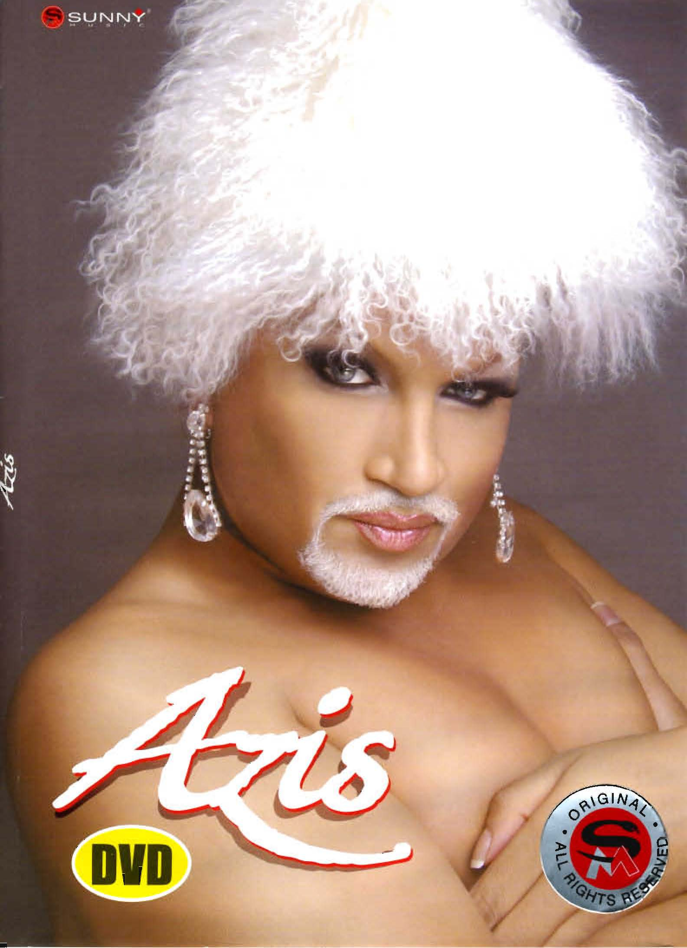
Gender/Sexuality Activism: Azis

Slide 8
Rise of Chalga (folk pop, BG) 1990s
Turbofolk (MK, Serbia)
Manele (Romania)
Many songs in kyuchek rhythms
But industry run by non-Roma (except Romania)
Controversy:
Hated by elites; “ruined” folk music
Kitsch: low class art form
Use of synthesizers
Crass, commercial, sexist pornographic, objectifies women

Slide 9
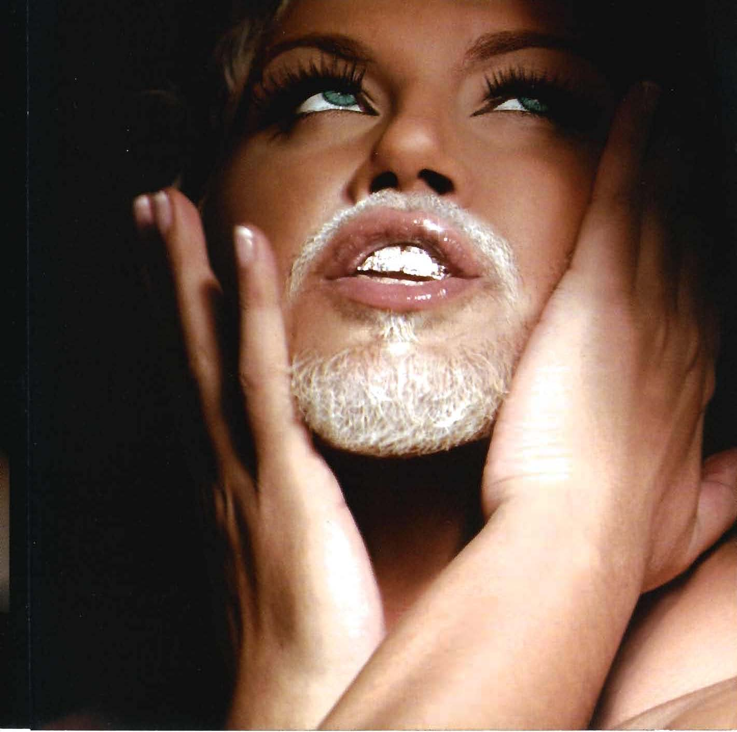

Slide 10
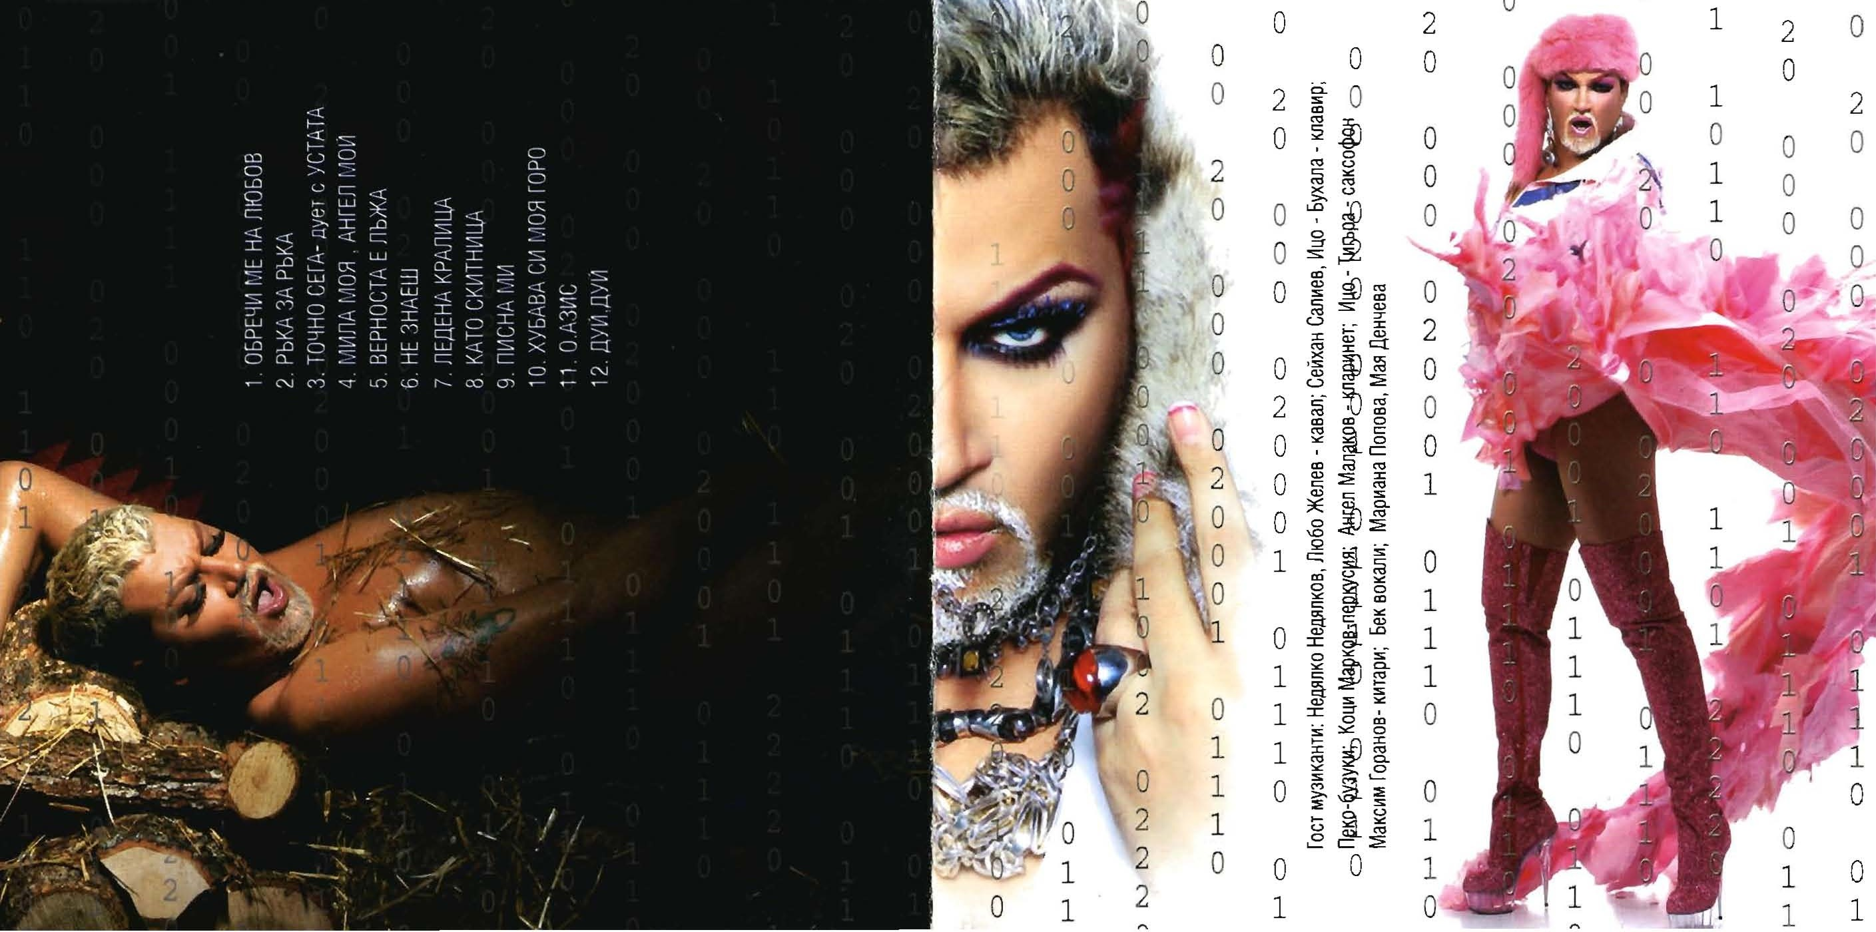

Slide 11
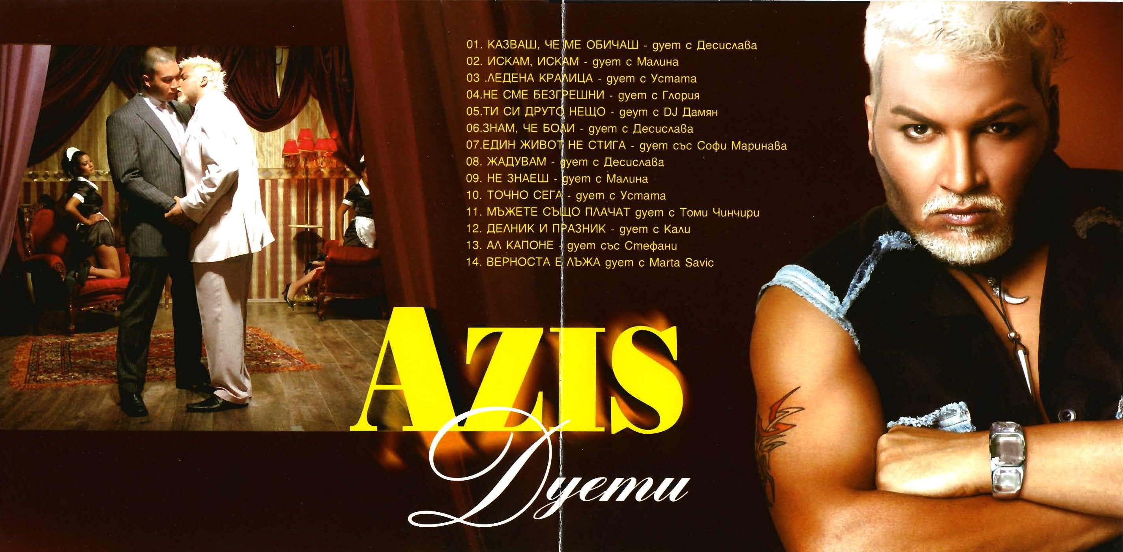

Slide 12
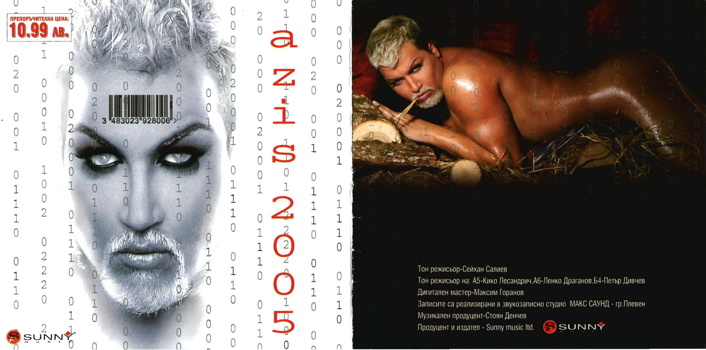

Slide 13
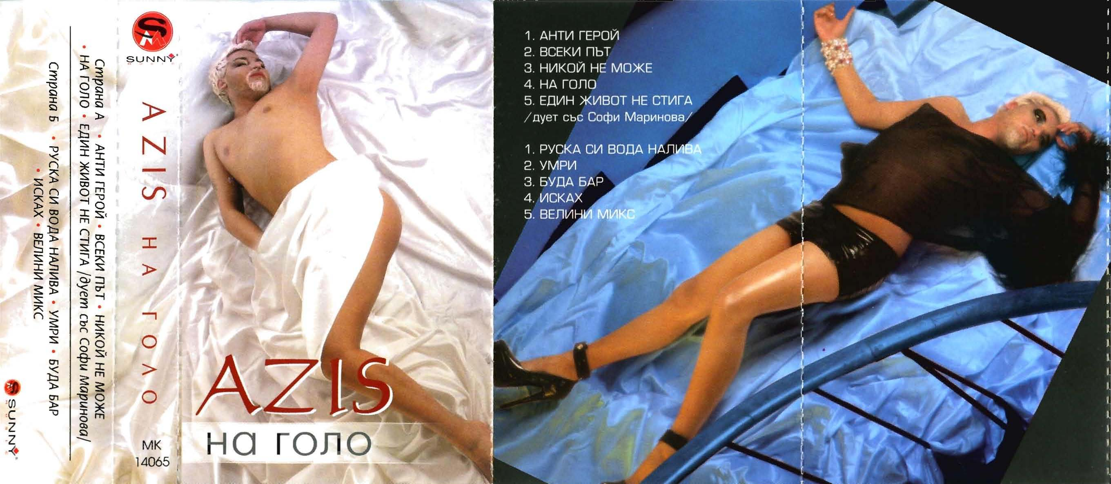
Azis, Naked

Slide 14
Azis: recent songs
Habibi (my love, Arabic) 2016
Motel 2017: diversity
Pozna li me (did you recognize me?) 2018: radical diversity
Ciganche (little Gypsy) (2019): Romani shame

Slide 15
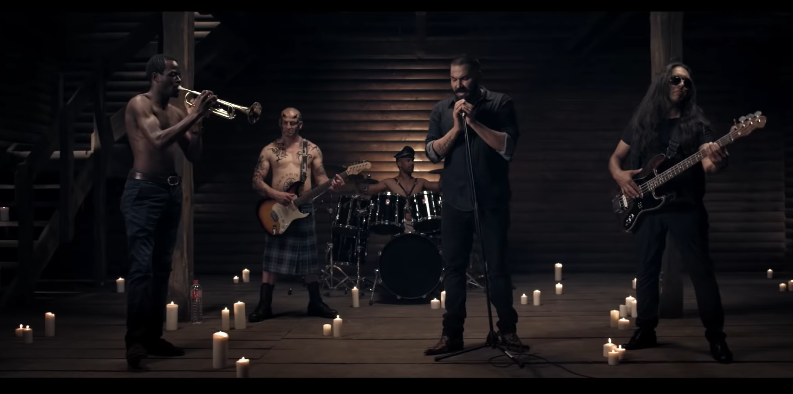
Azis 2018: Pozna li me? Did you recognize me? https://www.youtube.com/watch?v=Smdc5GcCM-As

Slide 16
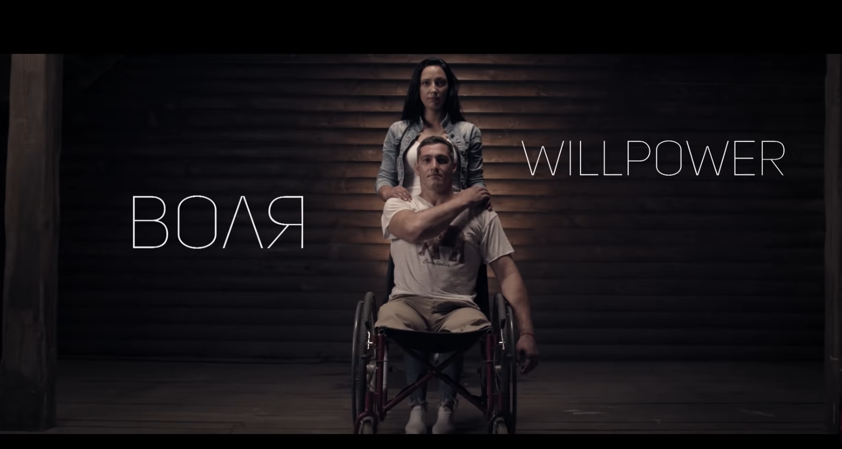

Slide 17
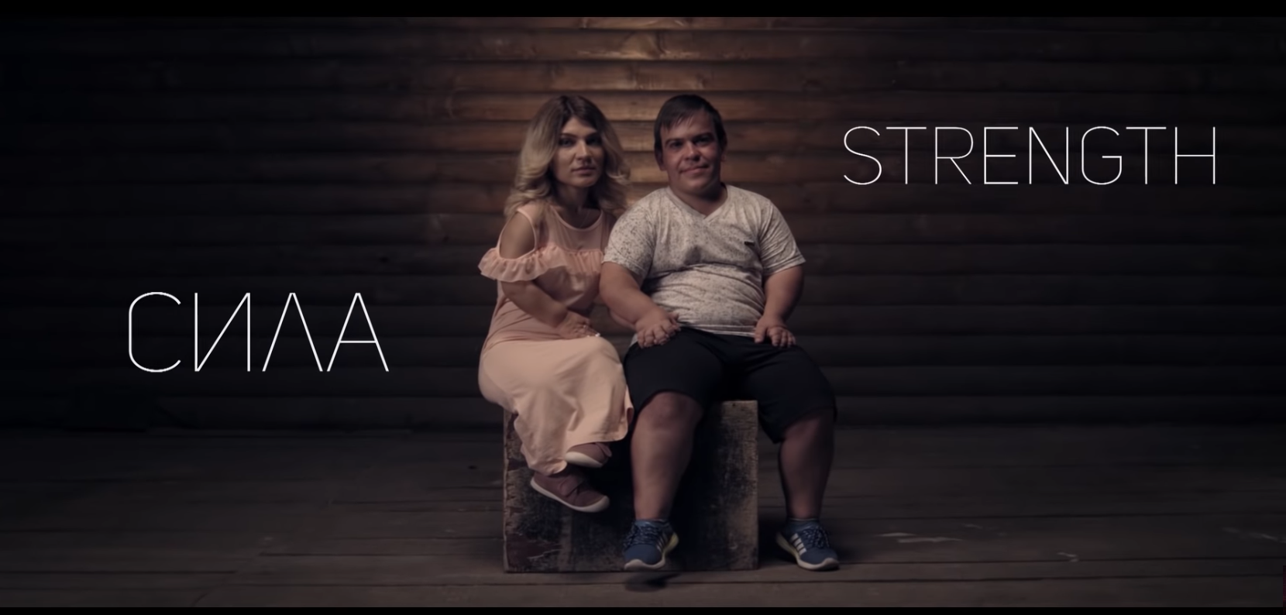

Slide 18
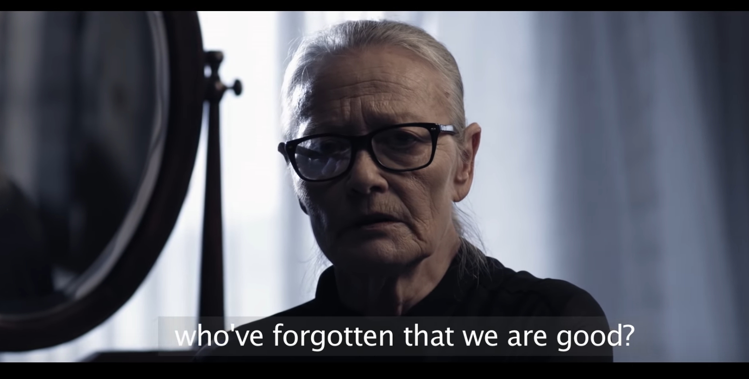
Famous film/stage actress
Tsvetana Maneva

Slide 19
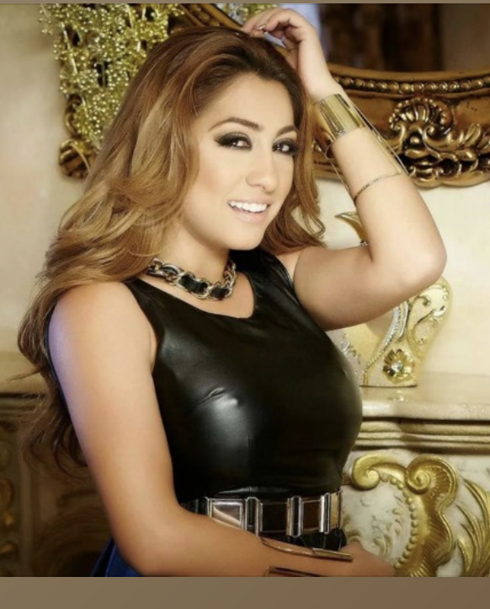
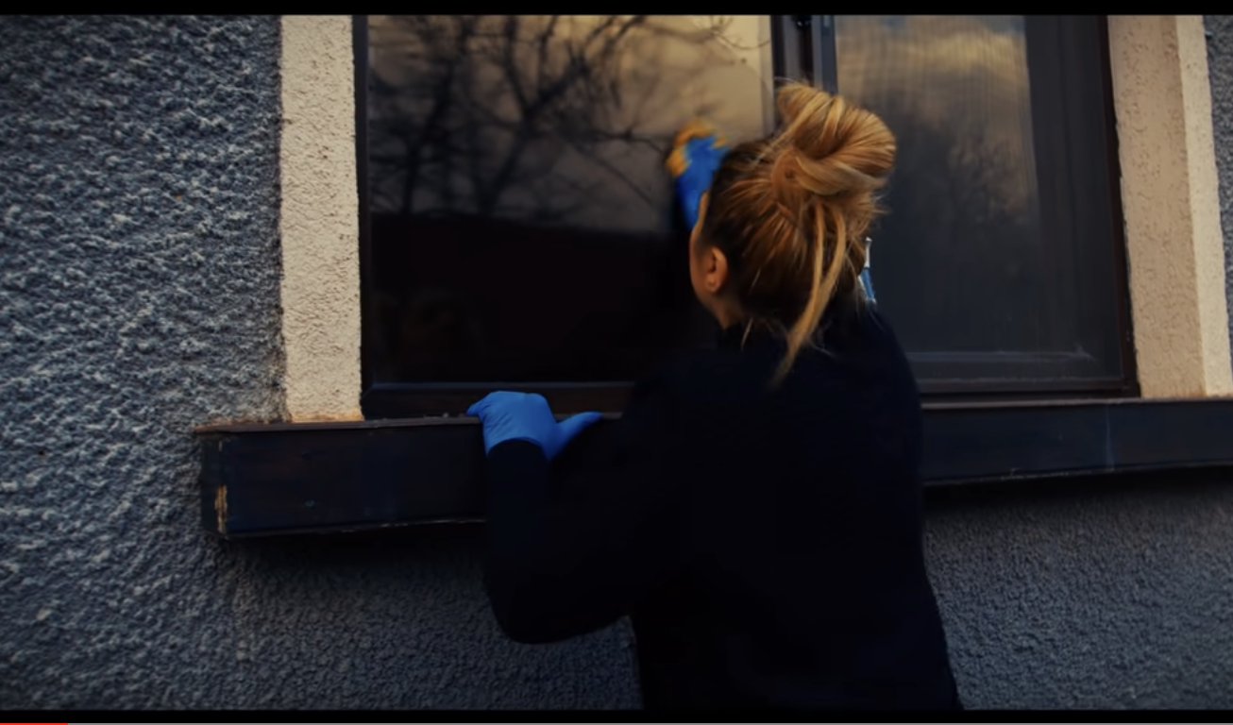
Roksana: chalga star embraces her Romani identity
“NYAMA DA E VSE TAKA” (IT WILL NOT ALWAYS BE LIKE THIS)

Slide 20
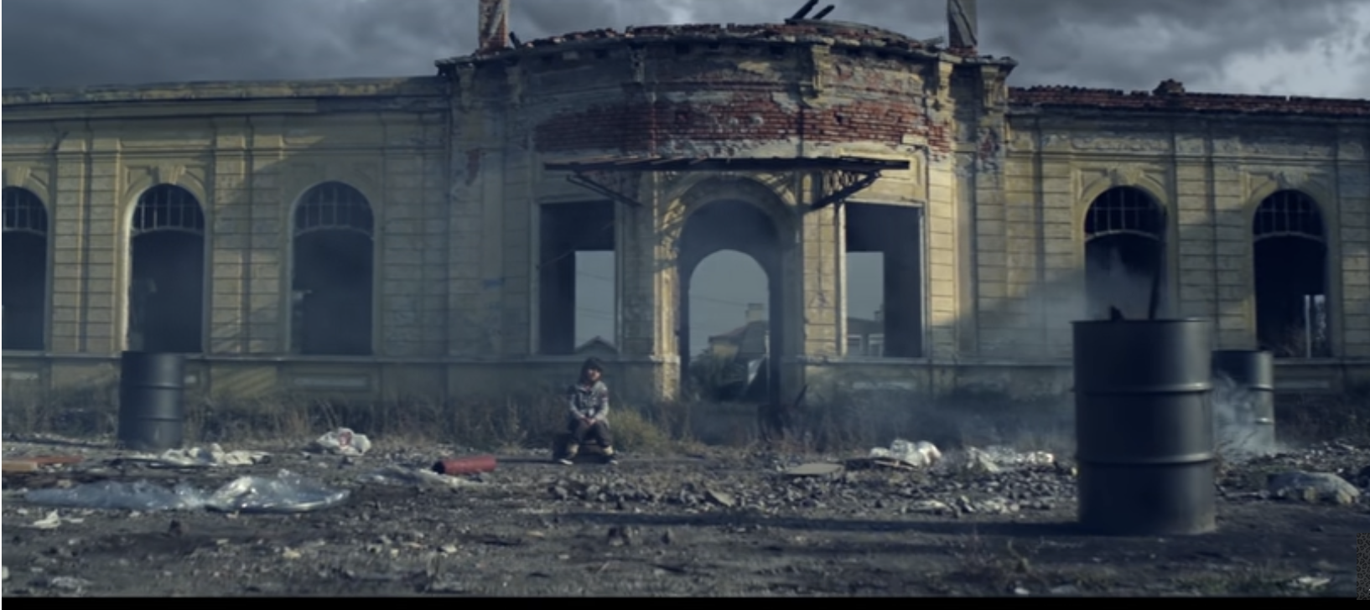
Djelem Djelem, Romani anthema: apocalyptic scenes of poverty and a diversity message

Slide 21
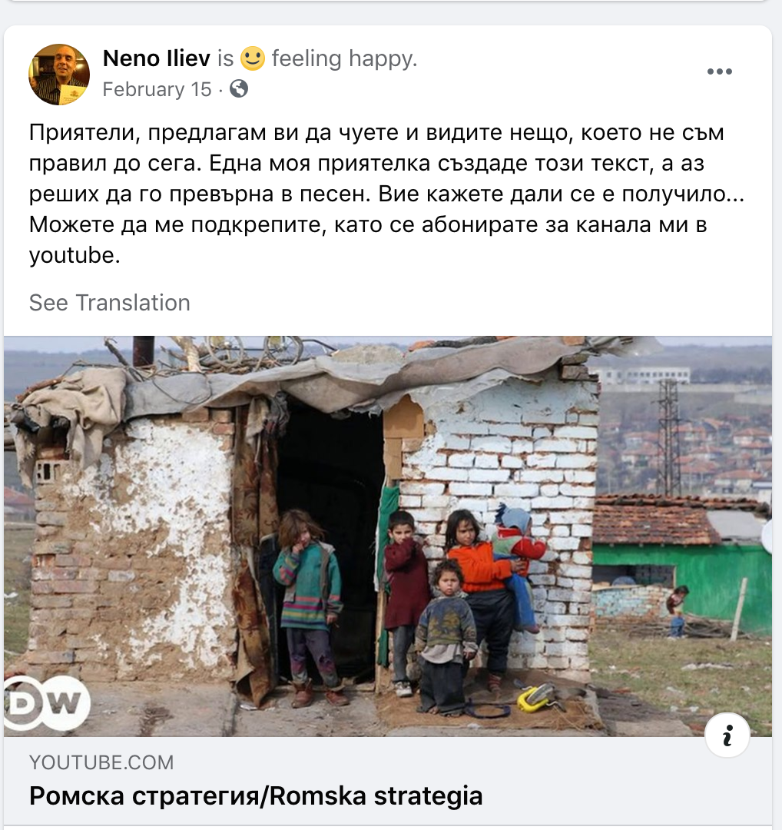
Romani singer Neno Iliev
2021 song and clip:
Romani Strategy
(2012 -20 Government plan)
Kyucheck with political text
https://www.youtube.com/watch?v=90lc5ynsA-Y&t=51s

Slide 22
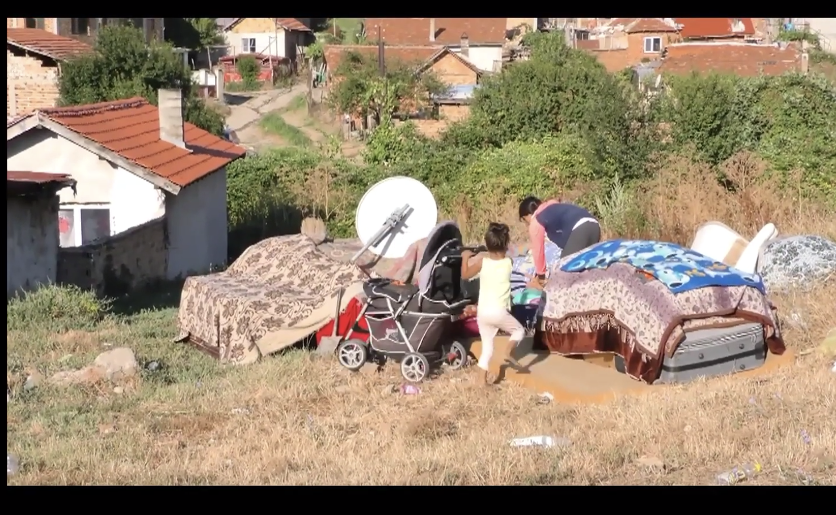
Dispossession of Roma after evictions

Slide 23
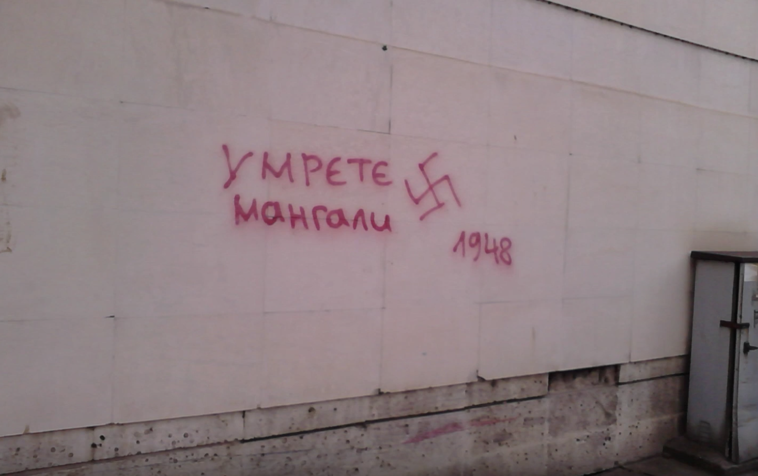
Death to mangali (slur for Roma)

Slide 24
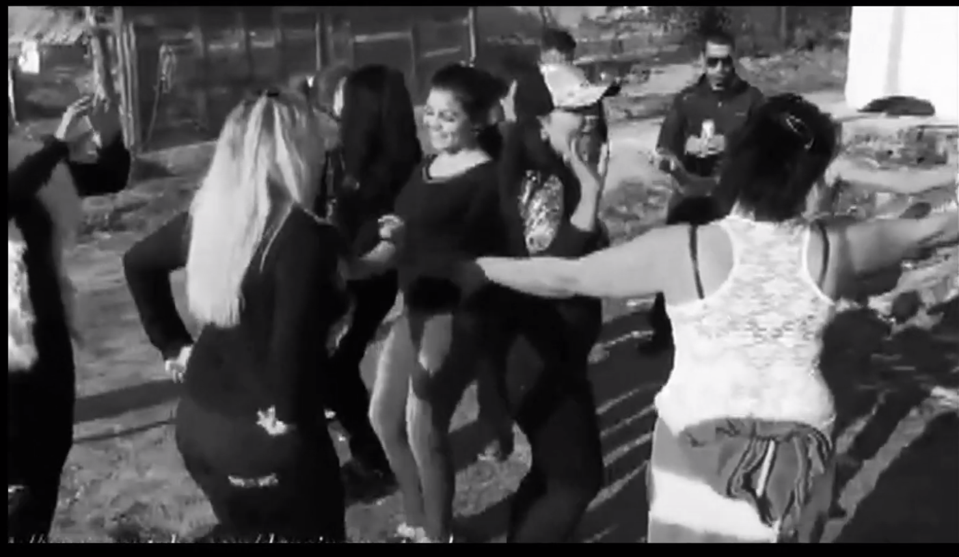
Chorus shows Roma dancing kyuchek:
“If I have drinks and food, nothing bothers me”

Slide 25
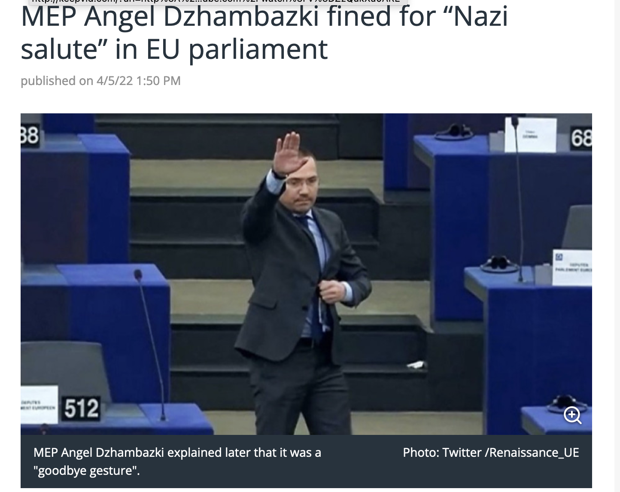
Current Wave of Musical Activism: Why Now?
Census 2021-2022
ERIAC: European Roma Institute for Arts/Culture
Alarming issues facing Balkan Roma:
High rates of prejudice, unemployment, violence
Police brutality, evictions
Surge in xenophobia
Hate speech normalized
COVID surveillance

Slide 26
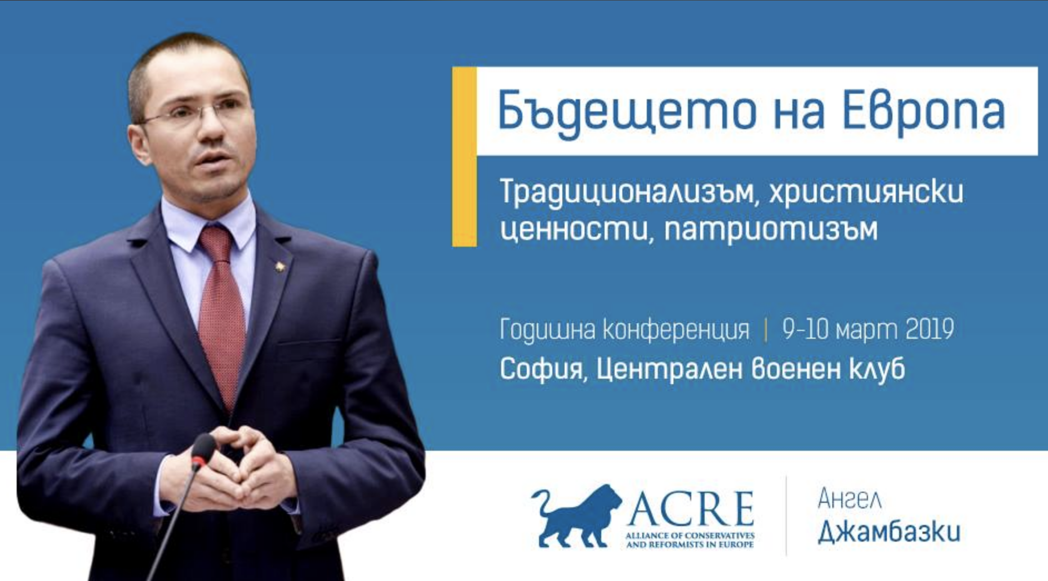
EU Alliance of Conservatives, The Future of Europe:
Traditionalism, Christian Values, Patriotism
Bulgarian MP Angel Dzhambazki
Notes:
ICH discourse (safeguarding) evokes the cultural object in danger-- the threat of globalization; what is ours needs to be protected.
This resonates with nationalist parties and platforms that see native culture under attack-- EU as meddling, sees gender rights as foreign concept, see Muslims and Roma as foreign and dangerous terrorists.
Nationalist websites images feature women and children—family values--in costume— at E Orthodox religious sites—
Dangerous images of Roma, Muslims, refugees, trans people, gay people, prostitutes
Folk music is ours. But village music is too obsolete old fashioned, so turn to pop music and even wedding bands.
MV—imagining the past—neo-traditional turn—
BG: authoritarian and even mainstream parties
Benjamin Teitelbaums’ of Bannon by right wing.
Retro- marketing—selected nostalgia
We want our country back again
Let’s make our country great again, patriotism tied to cultural pride
Multiculturalism is over
Ethnos before demos – race and ethnicity before citizenship

Slide 27
“People against Gypsy terror and invasion”
”Security for normal people” 2015

Slide 28
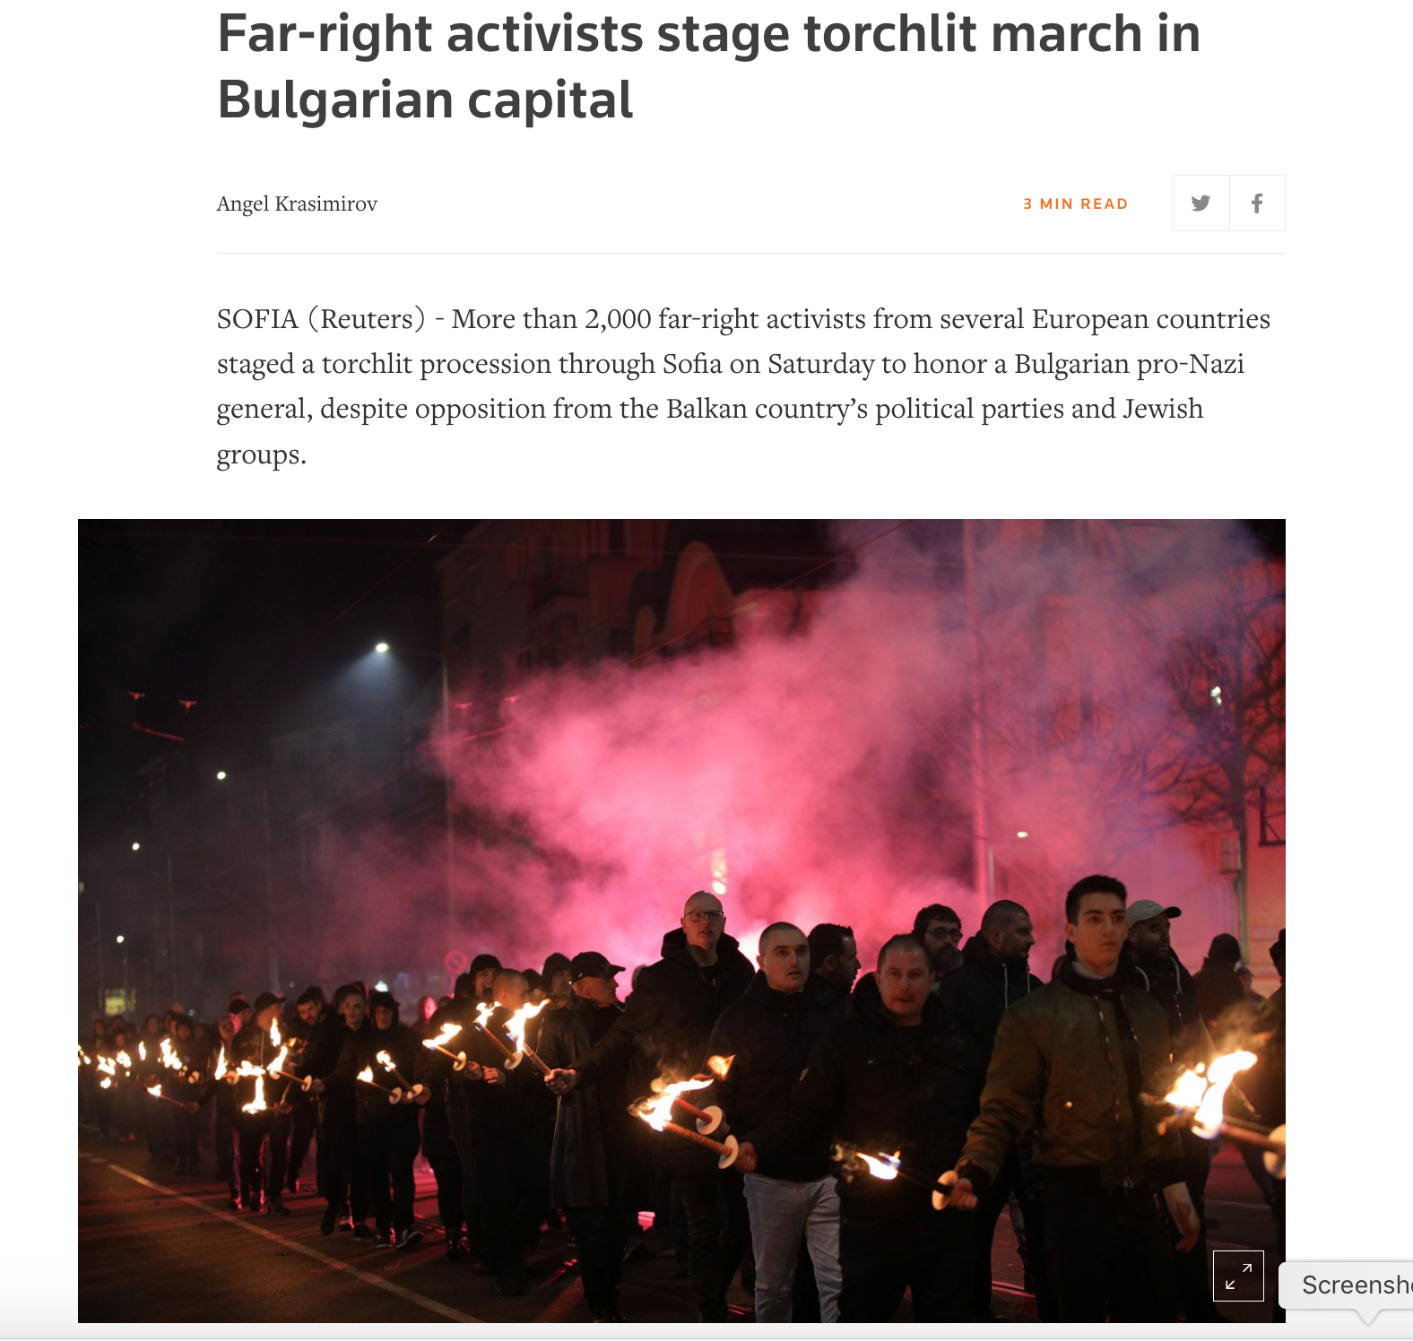
Neo-Nazi march
Sofia
Feb 17, 2019

Slide 29
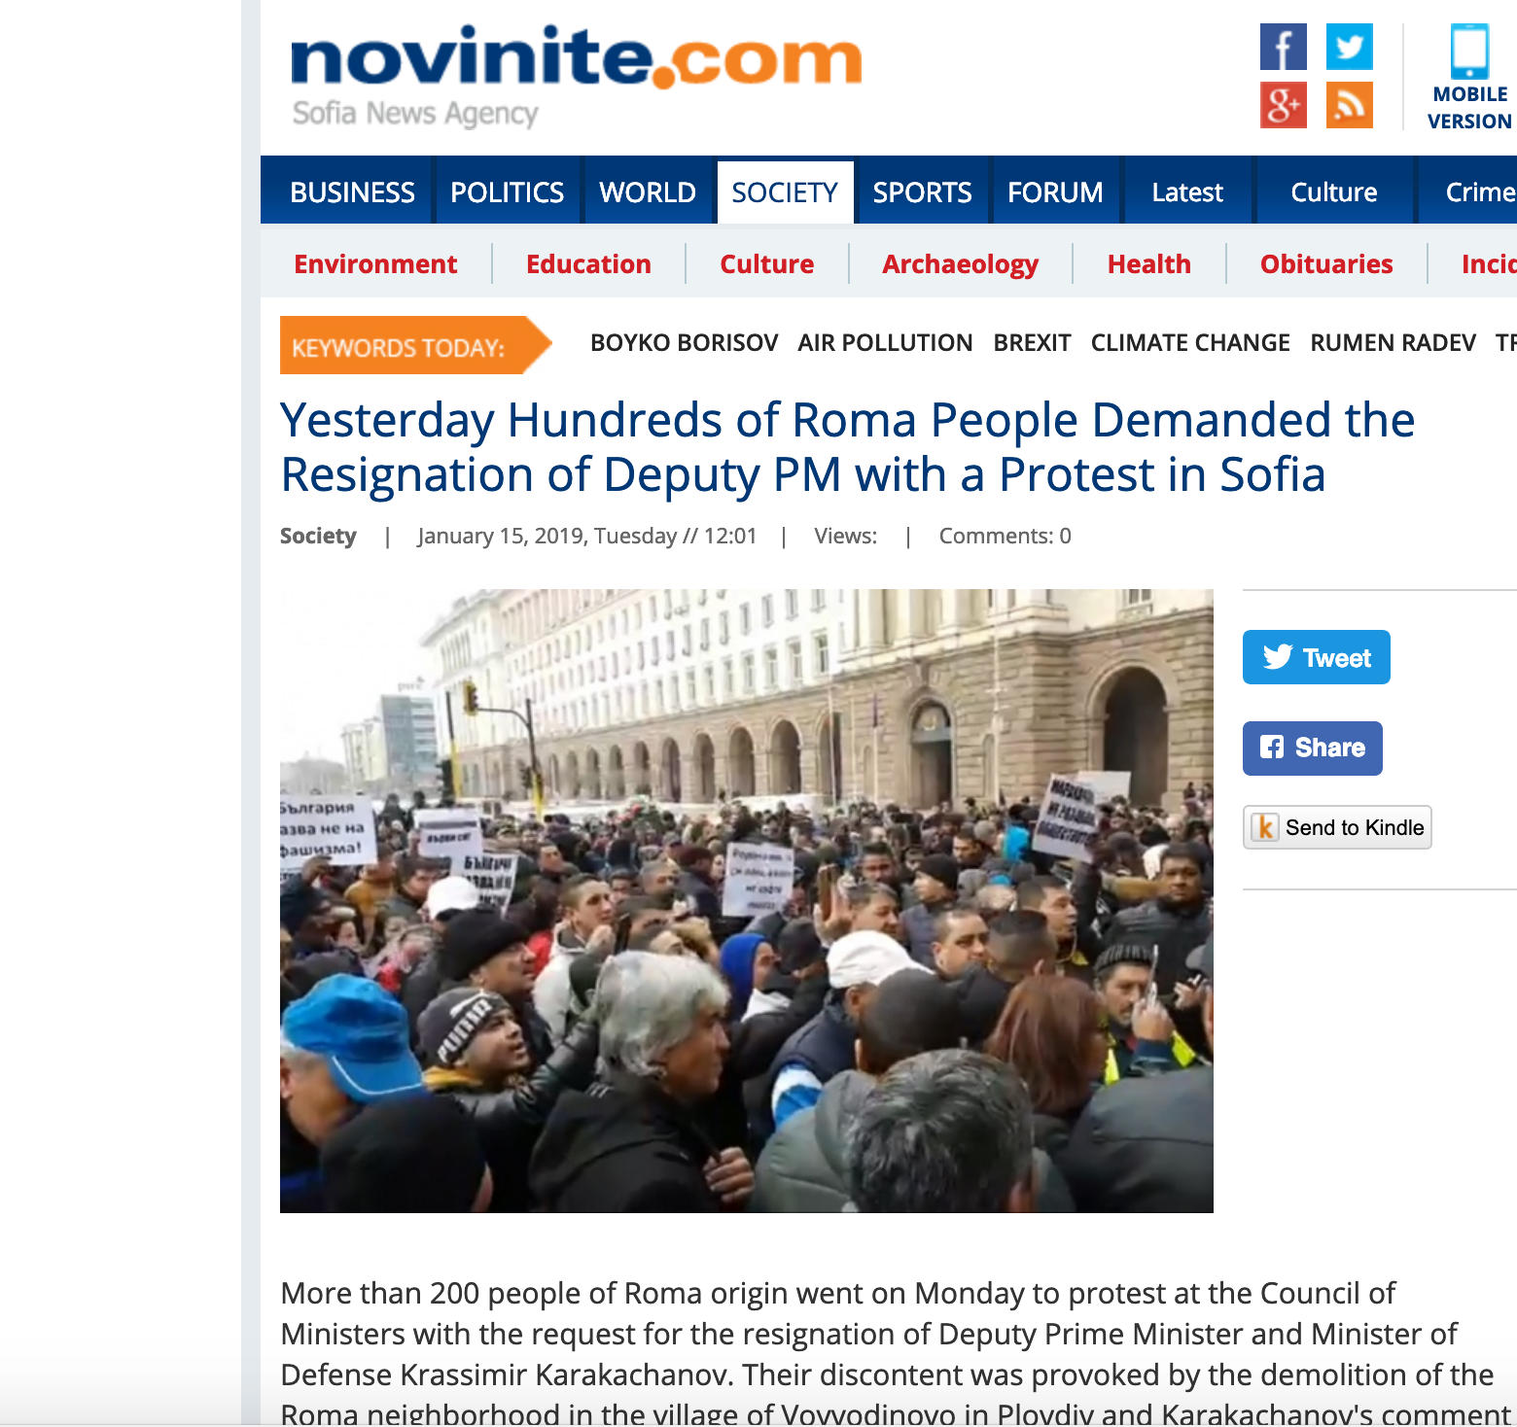
Protest by Roma
January
2019

Slide 30
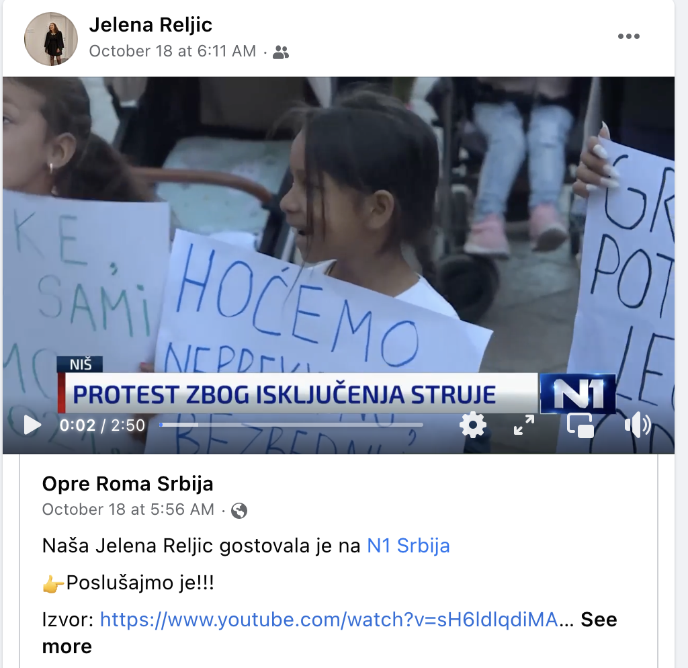
Current protests and court case in Niš, South Serbia
Re: Lack of electricity in a large Romani neighborhood

Slide 31
Justice Denied: Roma in the Criminal Justice System
(Serbia and North Macedonia, 2021)
Provides clear evidence that
“Institutional racism is embedded in the criminal justice system …. Romani defendants face discrimination from police, judges, prosecutors, and often their own lawyers…. Pervasive and routine antigypsyism in state and society leads to racially-biased decisions and outcomes for Roma …. Romani defendants are faced with discriminatory attitudes and biases that skew outcomes against them, so that the very system that is meant to impart fair and equal justice is, in fact, doing the opposite”
European Roma Rights Center

Slide 32
Music videos sponsored by ERIAC (European Roma Institute for Arts and Culture),
Open Society Foundation (OSF),
Proud Roma Campaign
Proud Roma Campaign: released before census to promote Romani identity
3 versions of Mahala Barvale (rich neighborhood):
3 melodies + scenarios: Serbian, Bulgarian, Macedonian
Text by activists from OSF, delivered to local Romani NGOs who recruit musicians. Each version features local stars:
Serbia: NGO Opre Roma Srbija: Marko Marković, Jelena Marković, Pretty Loud
Bulgaria: NGO Roma Standing Conference: Riko Band
Macedonia: NGO Avaja: Ervin Ametoski, Džambo Agušev, Amza King, Iso Mašina
Romanes + local Slavic language, no subtitles = local Romani audience

Slide 33
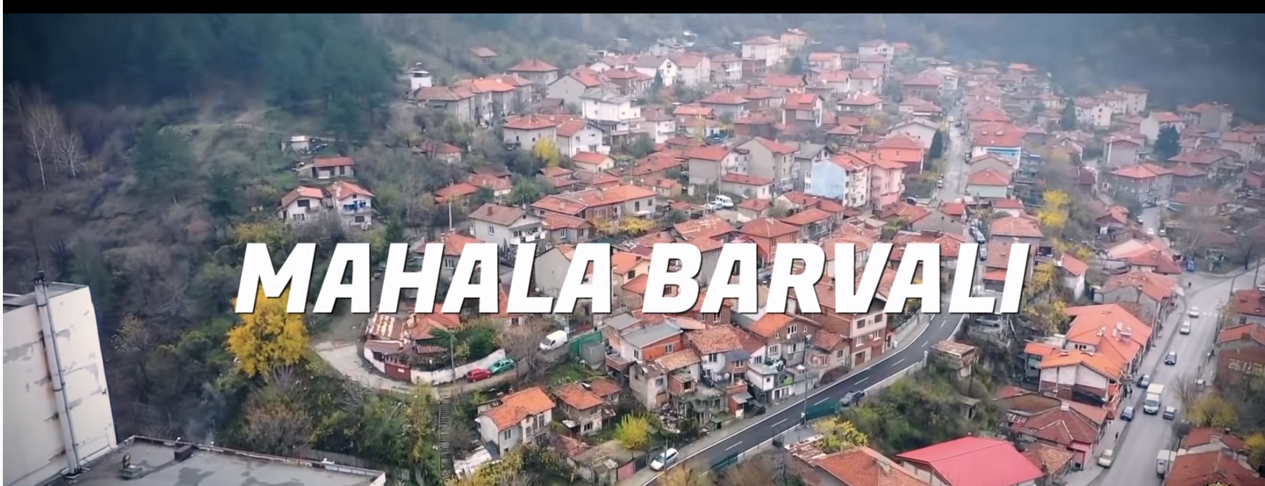
Mahala Barvali (rich neighborhood) features Roma as professionals, in school, respecting elders, preserving their crafts.
Many images of protest marches with Romani flag.
Music: Riko Band (chalga), 2020

Slide 34
Chorus: I mahala si barvali The neighborhood is rich
Amari zor si but bari our strength is great
Vast ko vast, ilo ko ilo hand to hand, heart to heart
Te vazda amaro Romano krlo to raise our Romani voice
Sa o Roma upre akana All Roma, rise up now
Našti te bešas, našti te daras we can't sit, we can't be afraid
Amare dušmaja but bare our enemies are many
Ajde te izborinamen kethane Let's fight together
Sa o Roma upre akana All Roma people stand up now
Pe sasti Evropa pe saste thema in all of Europe, in all lands
Amaro đivdipe, amari bah our lives, our luck
Te la ko amaro vas to take into our hands
RAP: Ušten Romalen, ušten sarine Stand up Roma, stand up everyone
Te ićeramen jedino ađikar shaj te ova po đande Sticking together is the only way we can be smarter
Ko Opre Roma te ova sar jekh Let's join the Opre Roma movement as one
Te osetin amaro Romano swag to feel our Roma swag
Amen sijam but šuže savorendar maj đande We are very beautiful, smarter than everyone
Amen sijam jekhutne na sijam amen manglje We are unique
E Romenđe te phrava đandipase udara Let's open doors with knowledge for Roma
Hem amen sijam manglje kotar o Devel And, we are loved by God

Slide 35
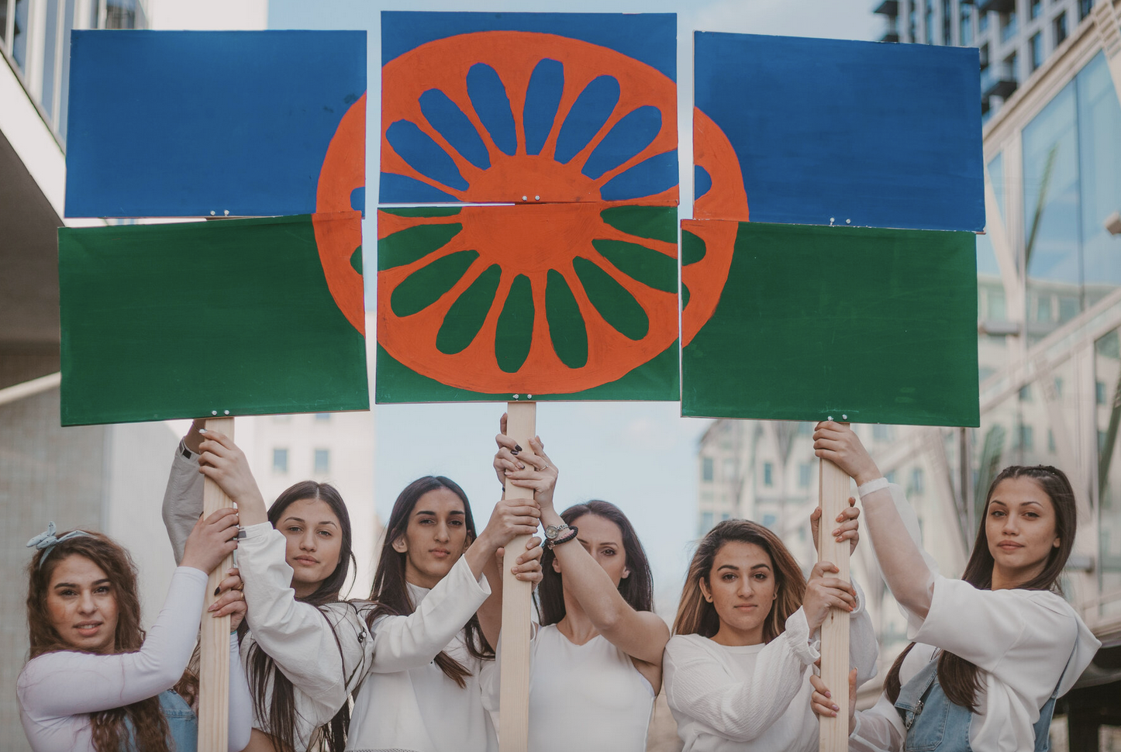
Pretty Loud: Serbian all female rap band

Slide 36
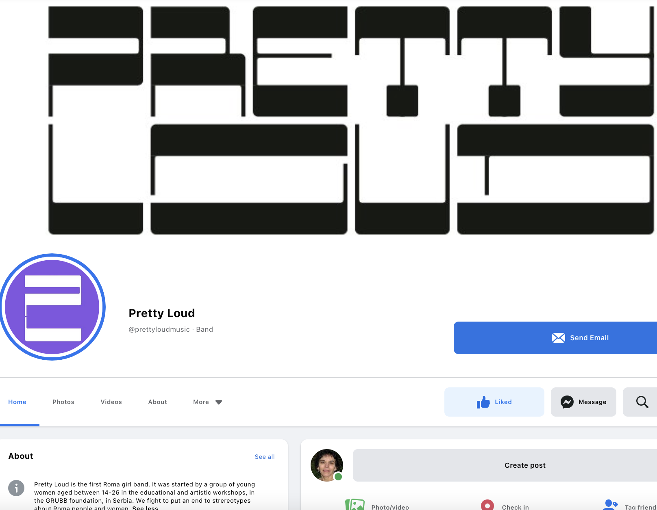

Slide 37
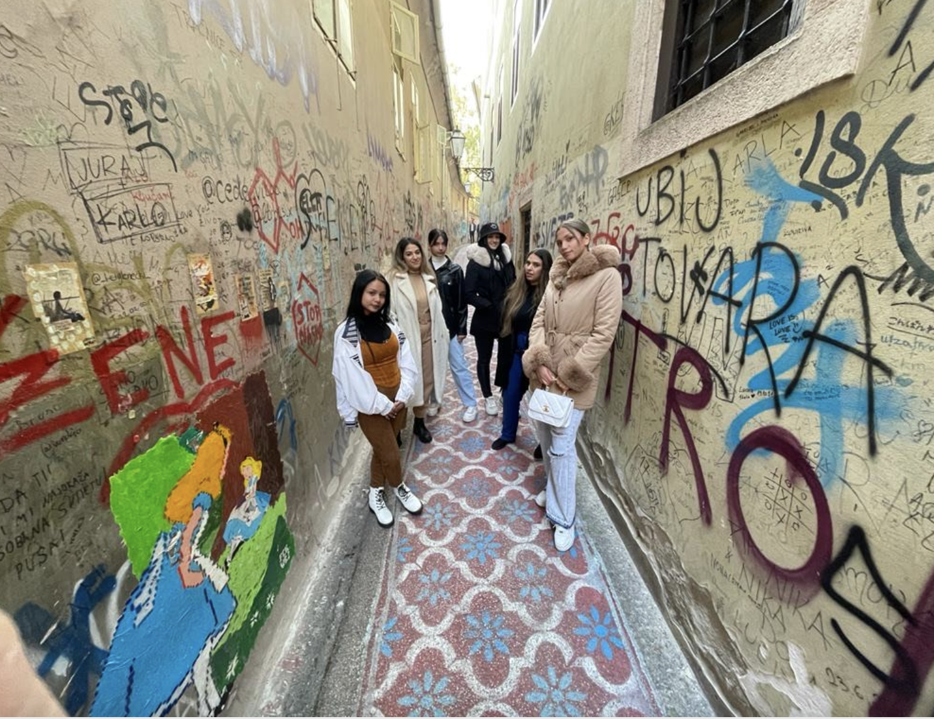
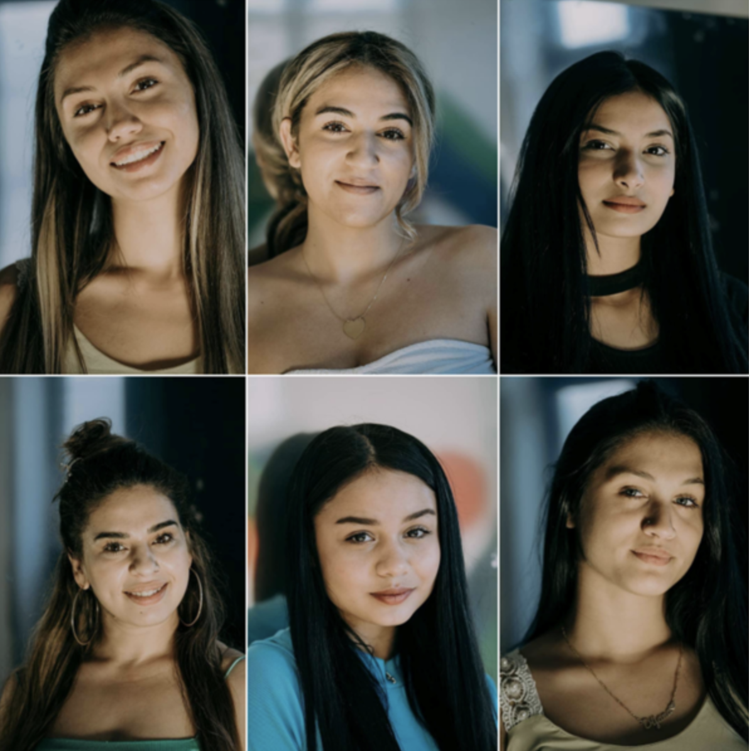
Formed 2020, women ages 14-26

Slide 38
From PRETTY LOUD’S website:
“Traditionally Roma women are homemakers, encouraged to leave school early and marry young.
Pretty Loud is breaking this mould by creating their own unique music, performances, and literary projects that aim to speak out for the next generation of Roma women.
They proudly blend rap and hip hop vocal styling with ancestral Roma music, and contemporary and urban movement with traditional dance.
Through their lyrics and writing they talk about their everyday challenges and hopes as well as more complex topics such as race, representation, and social justice.
They are passionate about putting an end to stereotypes about both Roma people and women.” - written by GRUBB

Slide 39
GRUBB Gypsy Roma Urban Balkan Beats,
Zemun, Belgrade (also Niš)
UK NGO founded in 2006 © Copyright GRUBB. All Rights Reserved. “Runs educational and artistic programmes, working predominantly in Serbia with Roma children and young people. GRUBB’s aim is to further their education in order that they may access mainstream employment, thereby facilitating their long-term social integration. Mission: GRUBB works with Roma children and youth so each can achieve their full potential and social integration. Vision: Our holistic approach, combining education, culture, arts, and business, enables social integration of minorities. ”
All donors are non-Roma
Classes in core education, plus rap , hip-hop, film, theatre, visual art.
Majority of teachers are non-Roma; recently Roma are promoted to teach

Slide 40
Texts about female independence
Obstacles to female empowerment: early marriage, dropping out of school. Emphasize education
Strive to provide models for girls
Work and housing discrimination; racialization
Domestic abuse; drugs prevalent
Proud of their neighborhood: not a ghetto, Romani flag
Depict taking care of children, families, and love relationships
Sing in Romanes, Serbian, English
https://www.youtube.com/watch?v=r-ezaPqeWwQ
https://www.youtube.com/watch?v=85uoOsHFpaM

Slide 41
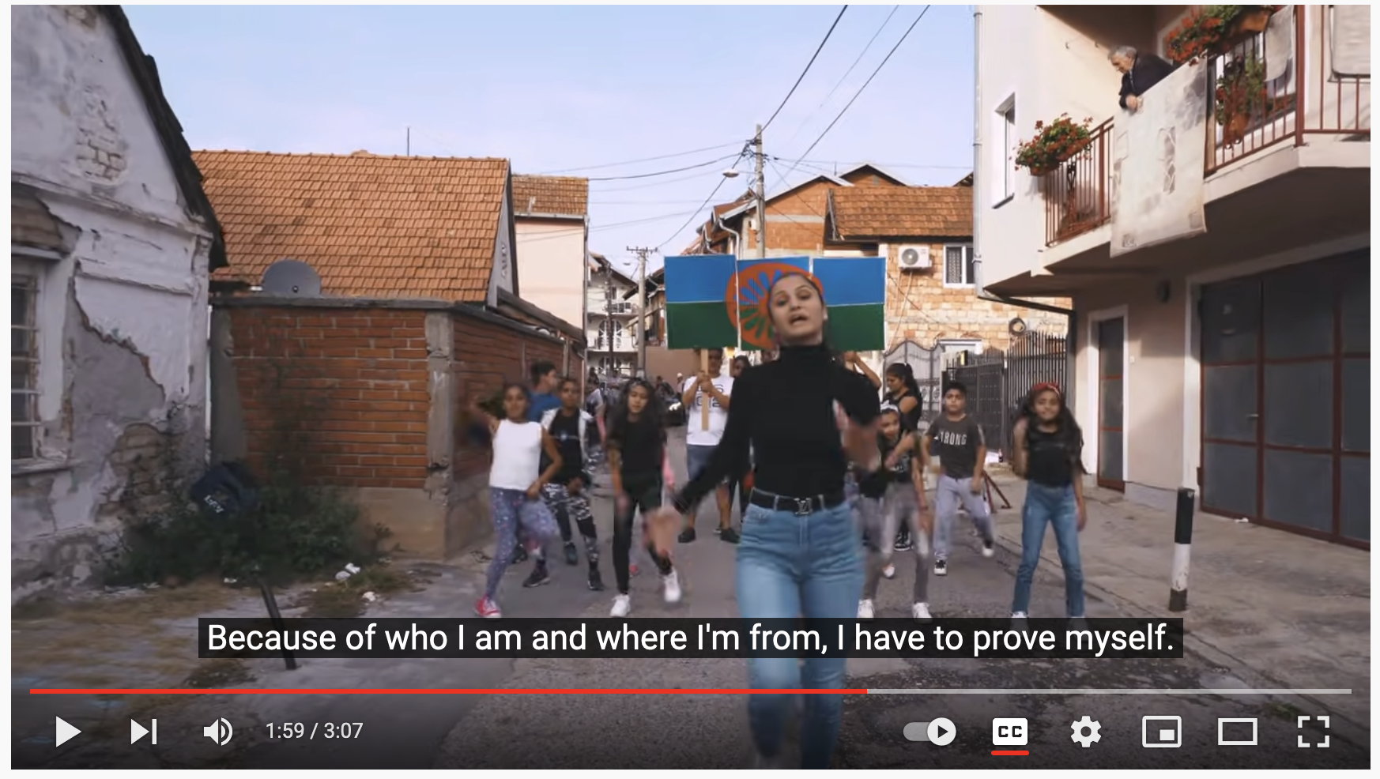
Pretty Loud Mashup: “I’m a proud Gypsy …. they don’t want me in the club. My skin is a different color, so they always want me out…”

Slide 42
Pretty Loud grew from rap and hip-hop classes
Their rap mentors are the Romani young men who performed in earlier GRUBB shows
Famous guest artists visit GRUBB from UK, France, and Canada to give workshops in hip hop and rap, eg., Serge Denoncourt
Staging is done by GRUBB staff, mostly men
Why rap?
“Ghetto music” for “ghetto people”??
Roma were channeled into rap; yet, but now, grassroots youth interest

Slide 43
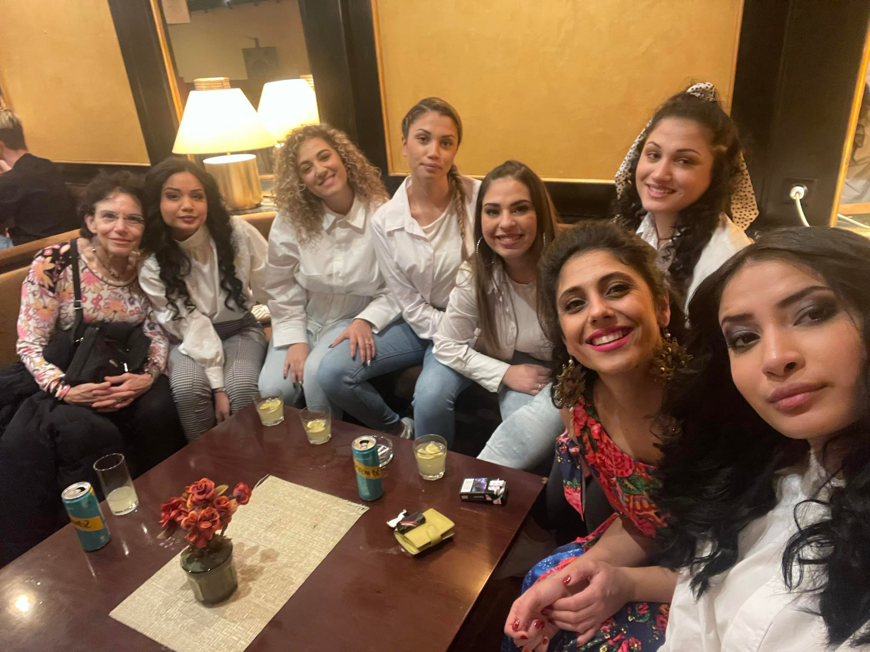
Backstage at 2021 Tajsa Celebration, Belgrade
European Romani Institute for Arts and Culture ERIAC

Slide 44
Ravnopravno (equal): domestic abuse

