Slide 1
Migration of Roma from the Balkans to Western Europe, the USA, Canada and Australia
1960s gurbet (working abroad), sponsored by Yugoslavia
1989+ end of communism
1990s war in Yugoslavia
1999 war in Kosovo
Today: very strict rules of immigration

Slide 2
Kosovo Roma
1999:
100,000 RAE (Roma, Ashkali, Egyptians)
representing 2/3 of the Romani population
fled Kosovo and settled in neighboring states and Western Europe
Only 50,000 remain in Kosovo

Slide 3
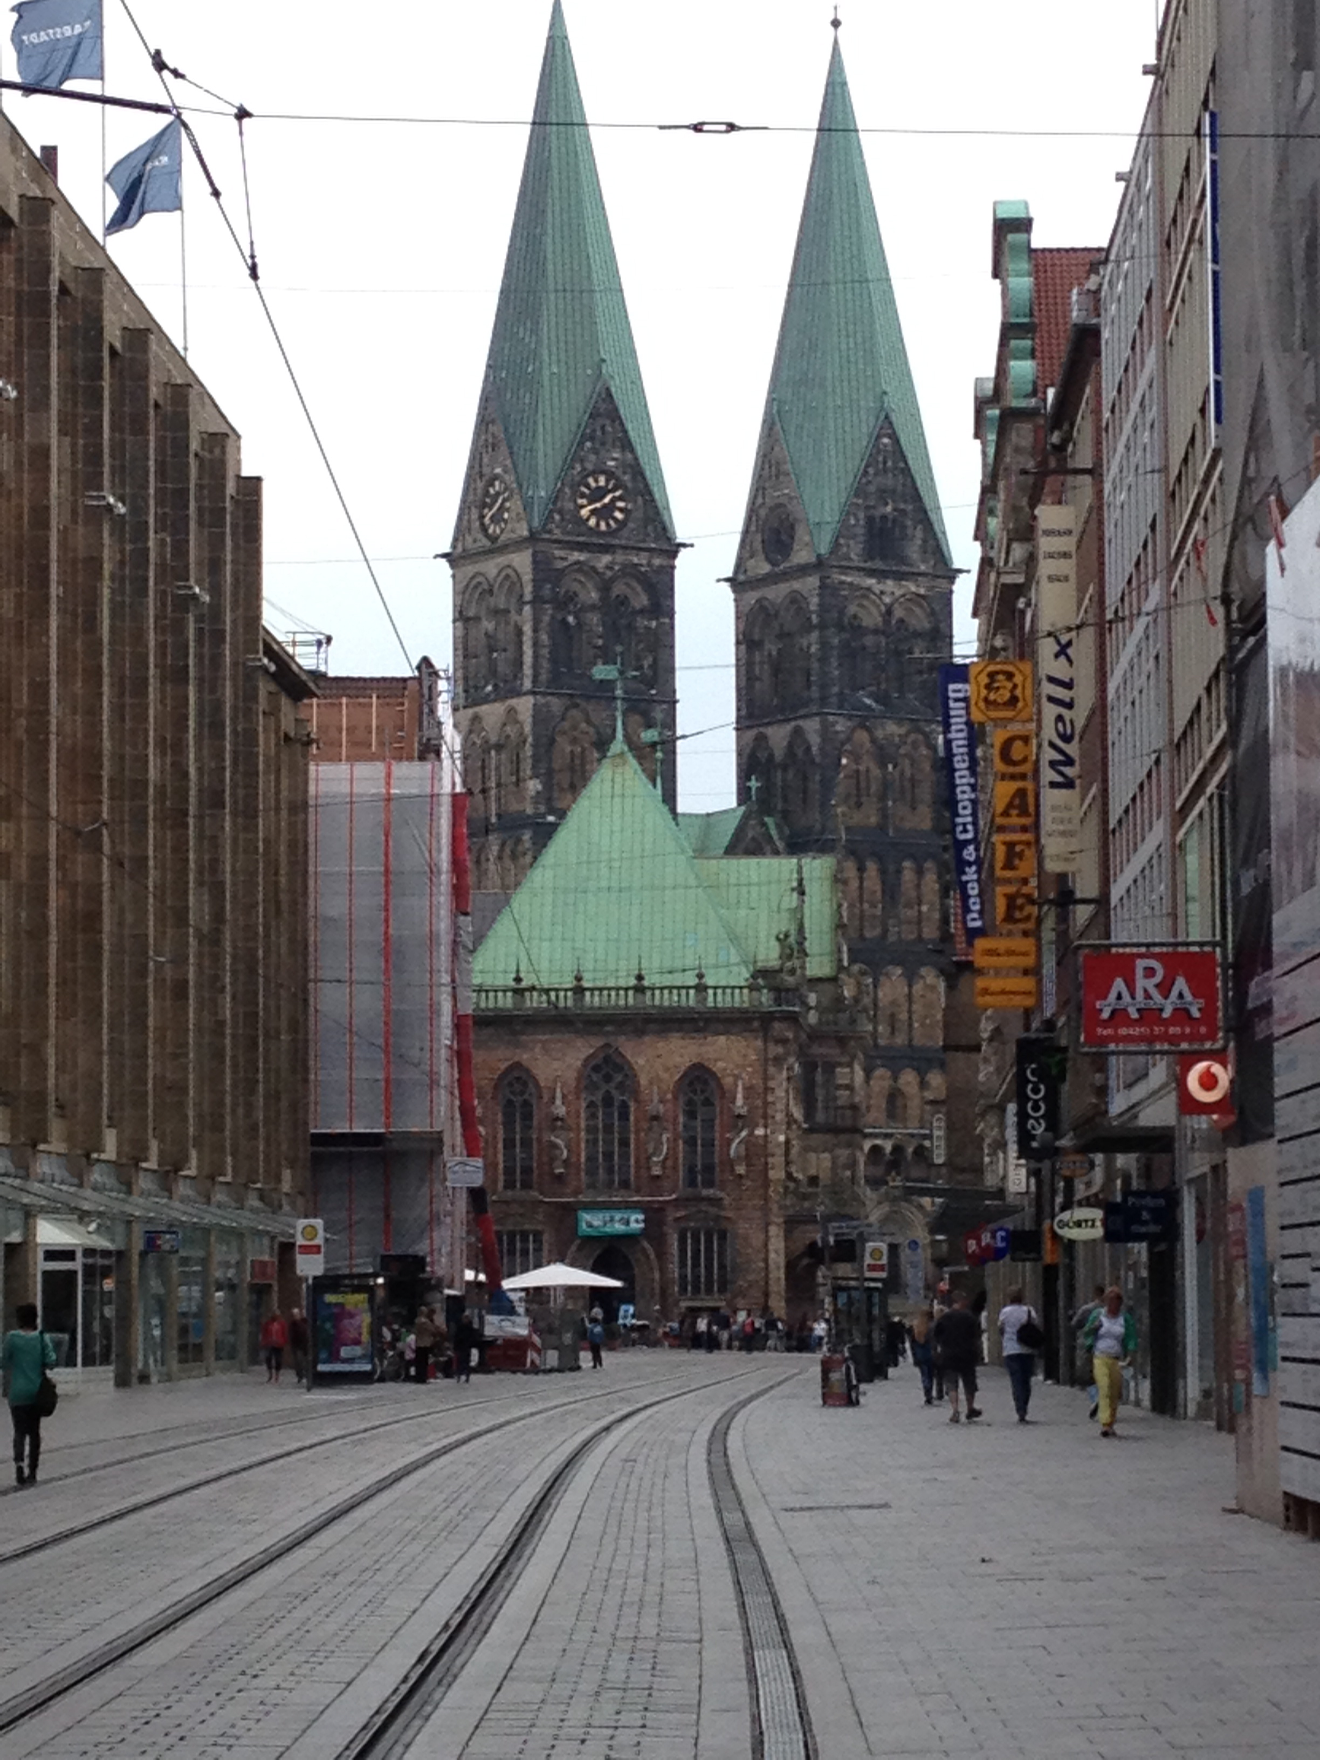
Bremen Center

Slide 4
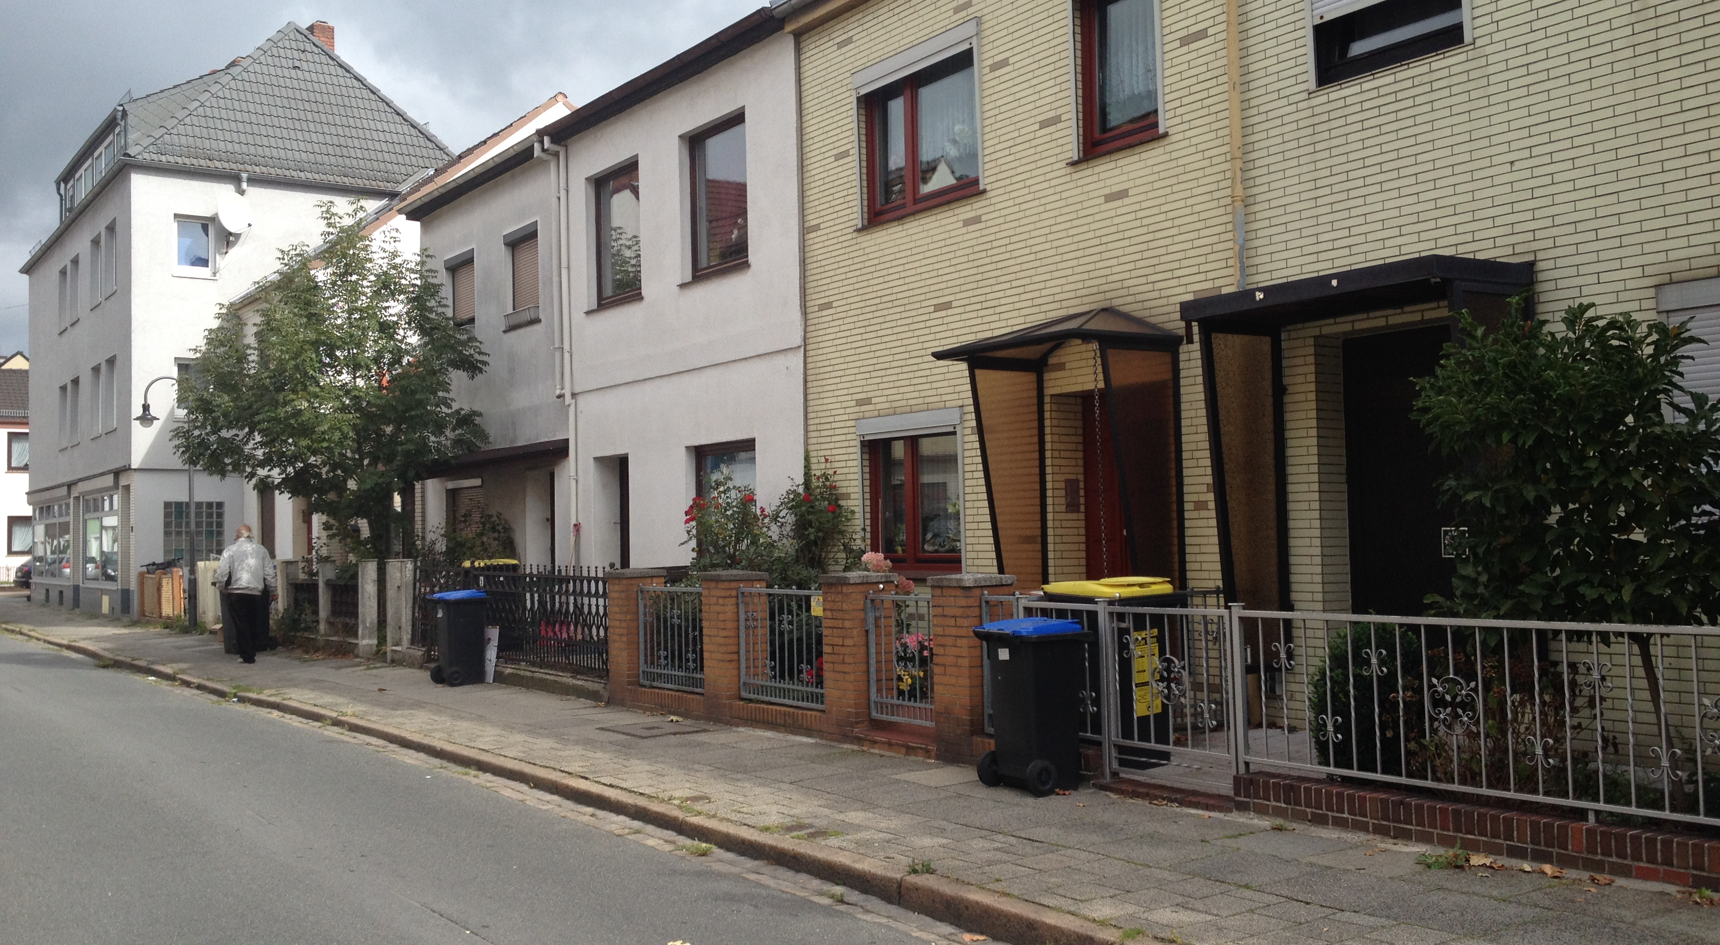
Working class neighborhood

Slide 5
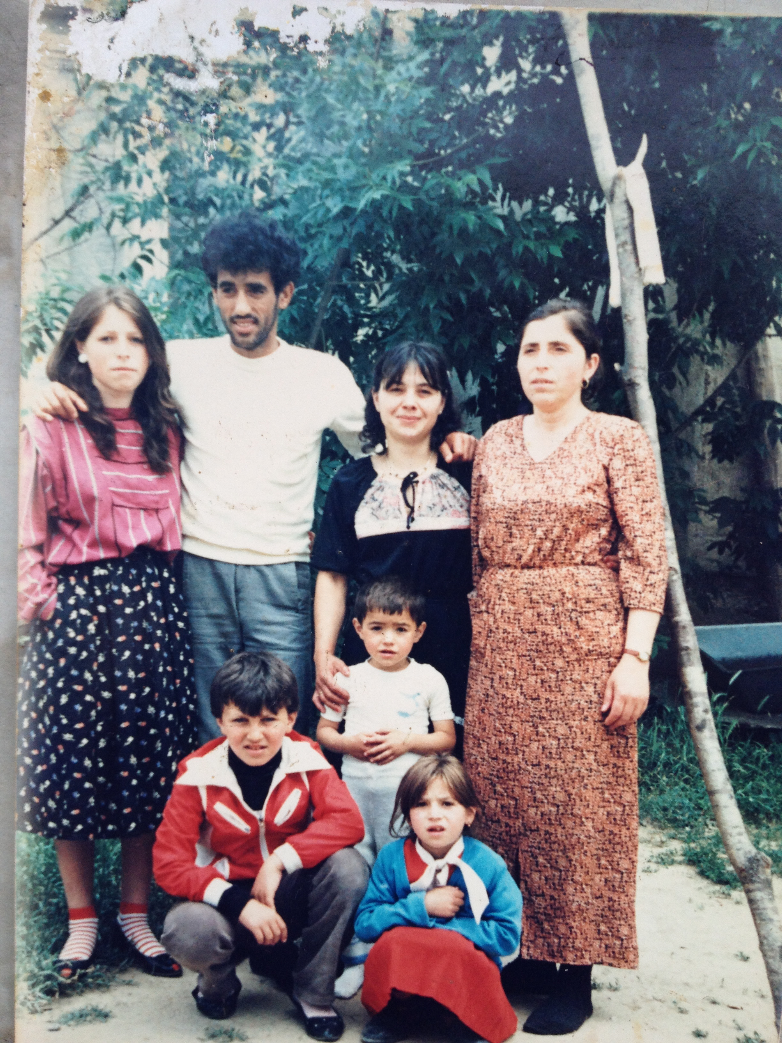
Pristina, 1980s: Kosovo RAE had high rates of education in Yugoslavia

Slide 6
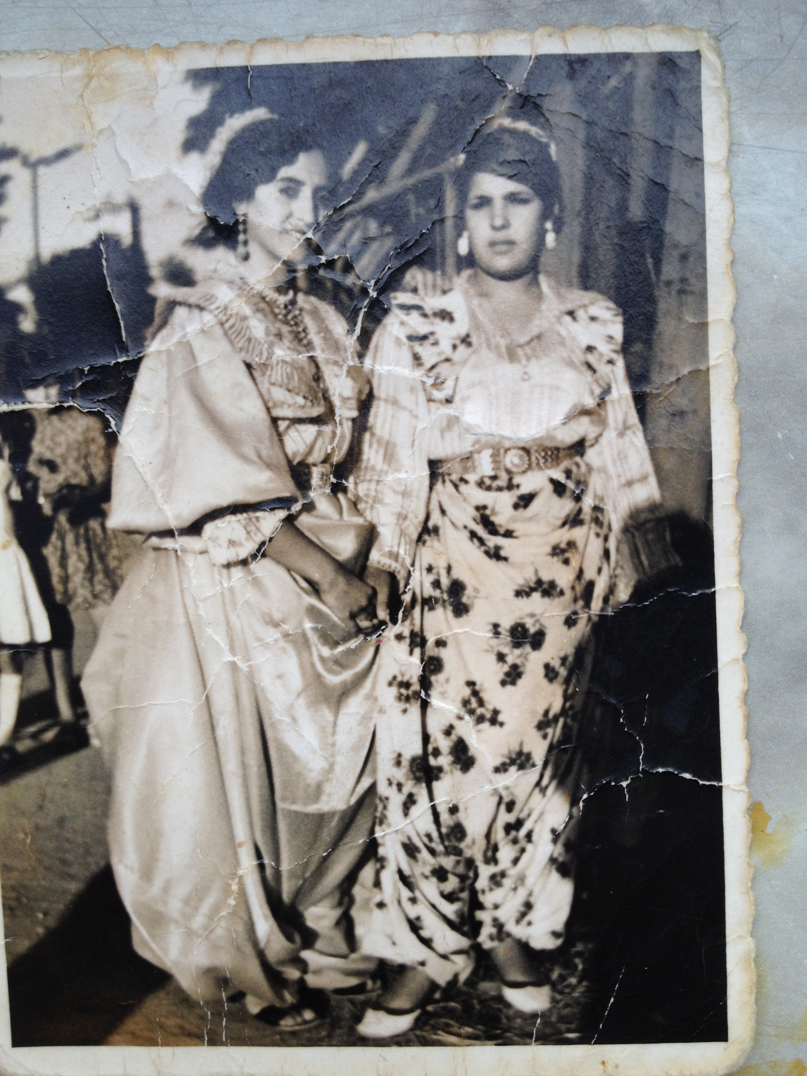

Slide 7
1990s Trauma of war and migration
Roma caught between Serb and Albanian conflict
1999 NATO bombing
Forced flight
Families bribed multiple mafias
Harrowing narratives of land and sea escape
Women played a prominent role
Men were incapable or absent
Families separated due to varying national policies
Now live in many West European countries

Slide 8
Kosovo Roma
Numerous deportations from Western Europe
“unworthy migrants” “failure to integrate”
anti-immigrant policies
Muslim Roma assumed to be terrorists: surveillance
Trauma in Kosovo:
Property loss
1999 UNMIK established camps for Roma in
North Mitrovica on toxic land poisoned with lead
Camps demolished in 2010
2016: UN Human Rights Advisory Panel condemns UN, advises compensation
Kosovo declared a “safe” country by European Commission 2015

Slide 9
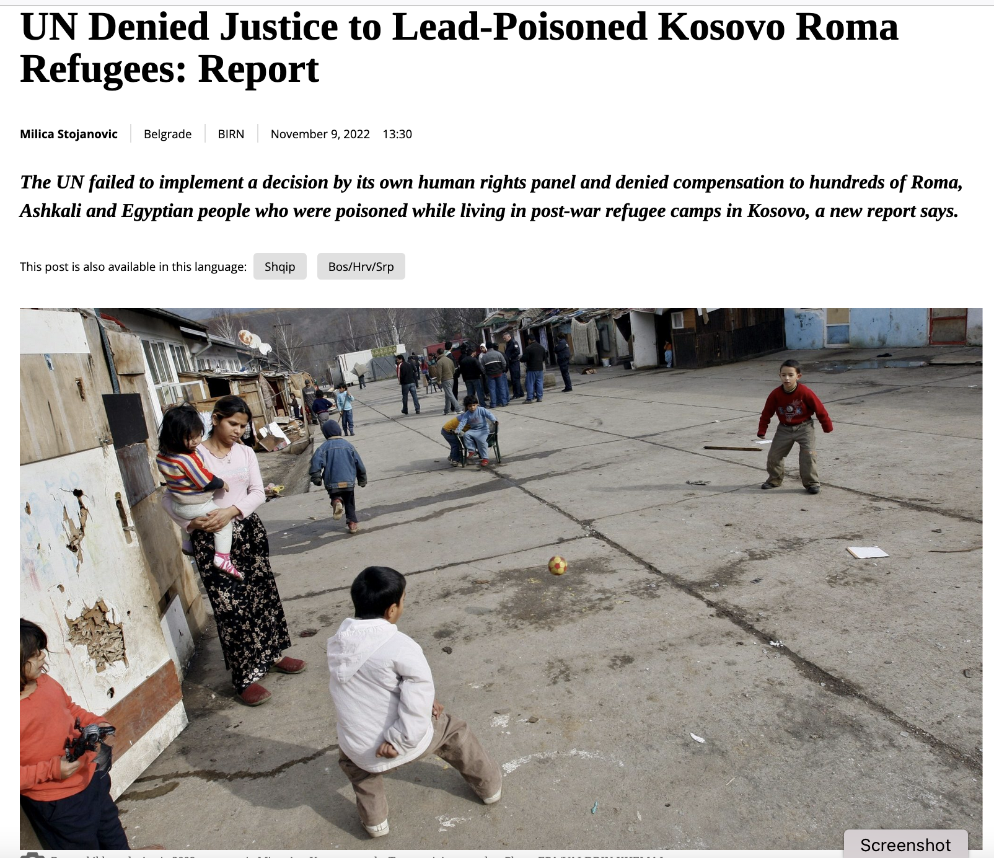
https://balkaninsight.com/2022/11/09/un-denied-justice-to-lead-poisoned-kosovo-roma-refugees-report/

Slide 10
Comparing Romani Muslim families in Germany (from Kosovo, 1999) and New York (from Macedonia from 1960s):
Cultural identities change in response to varied contexts.
Community members make selective choices about ritual, work, language, religion, and expressive culture.
Culture strategically changes in relationship to politics, and to gendered issues of independence, family size and class status.

Slide 11
Womens’ roles remain traditional,
but younger women are gaining more education.
Modesty, virginity, brideprice, and music and dance, which are embedded in
performative ritual displays,
are upheld as “tradition.”
For Kosovo migrants, ritual (including music and dance) is an area of safety, security. Diasporic families gather for celebrations.

Slide 12
Migrants embrace education
Women outpacing men in education and work advancement
Language change: Macedonian Roma in US losing Romani, but speak some Macedonian; Macedonian Roma and Kosovo Roma in Western Europe still speak Romani
Islam growing
Importance of music and dance: changing genres: Talava

Slide 13
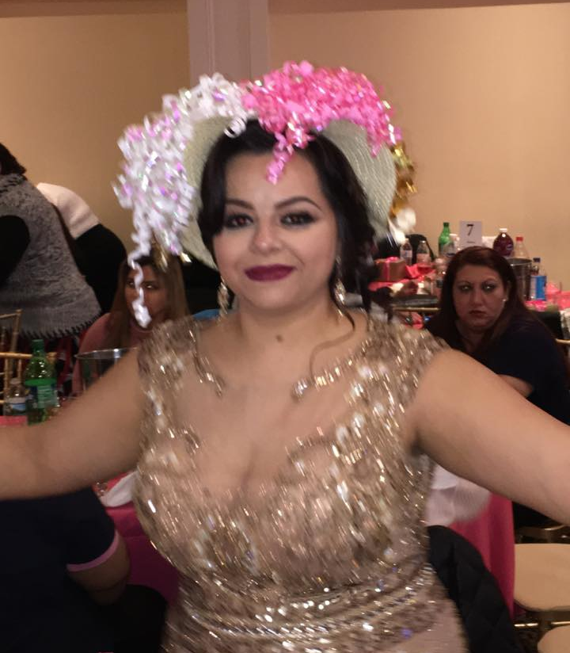
“New” rituals
Bridal
Shower
NYC, Macedonian Roma

Slide 14
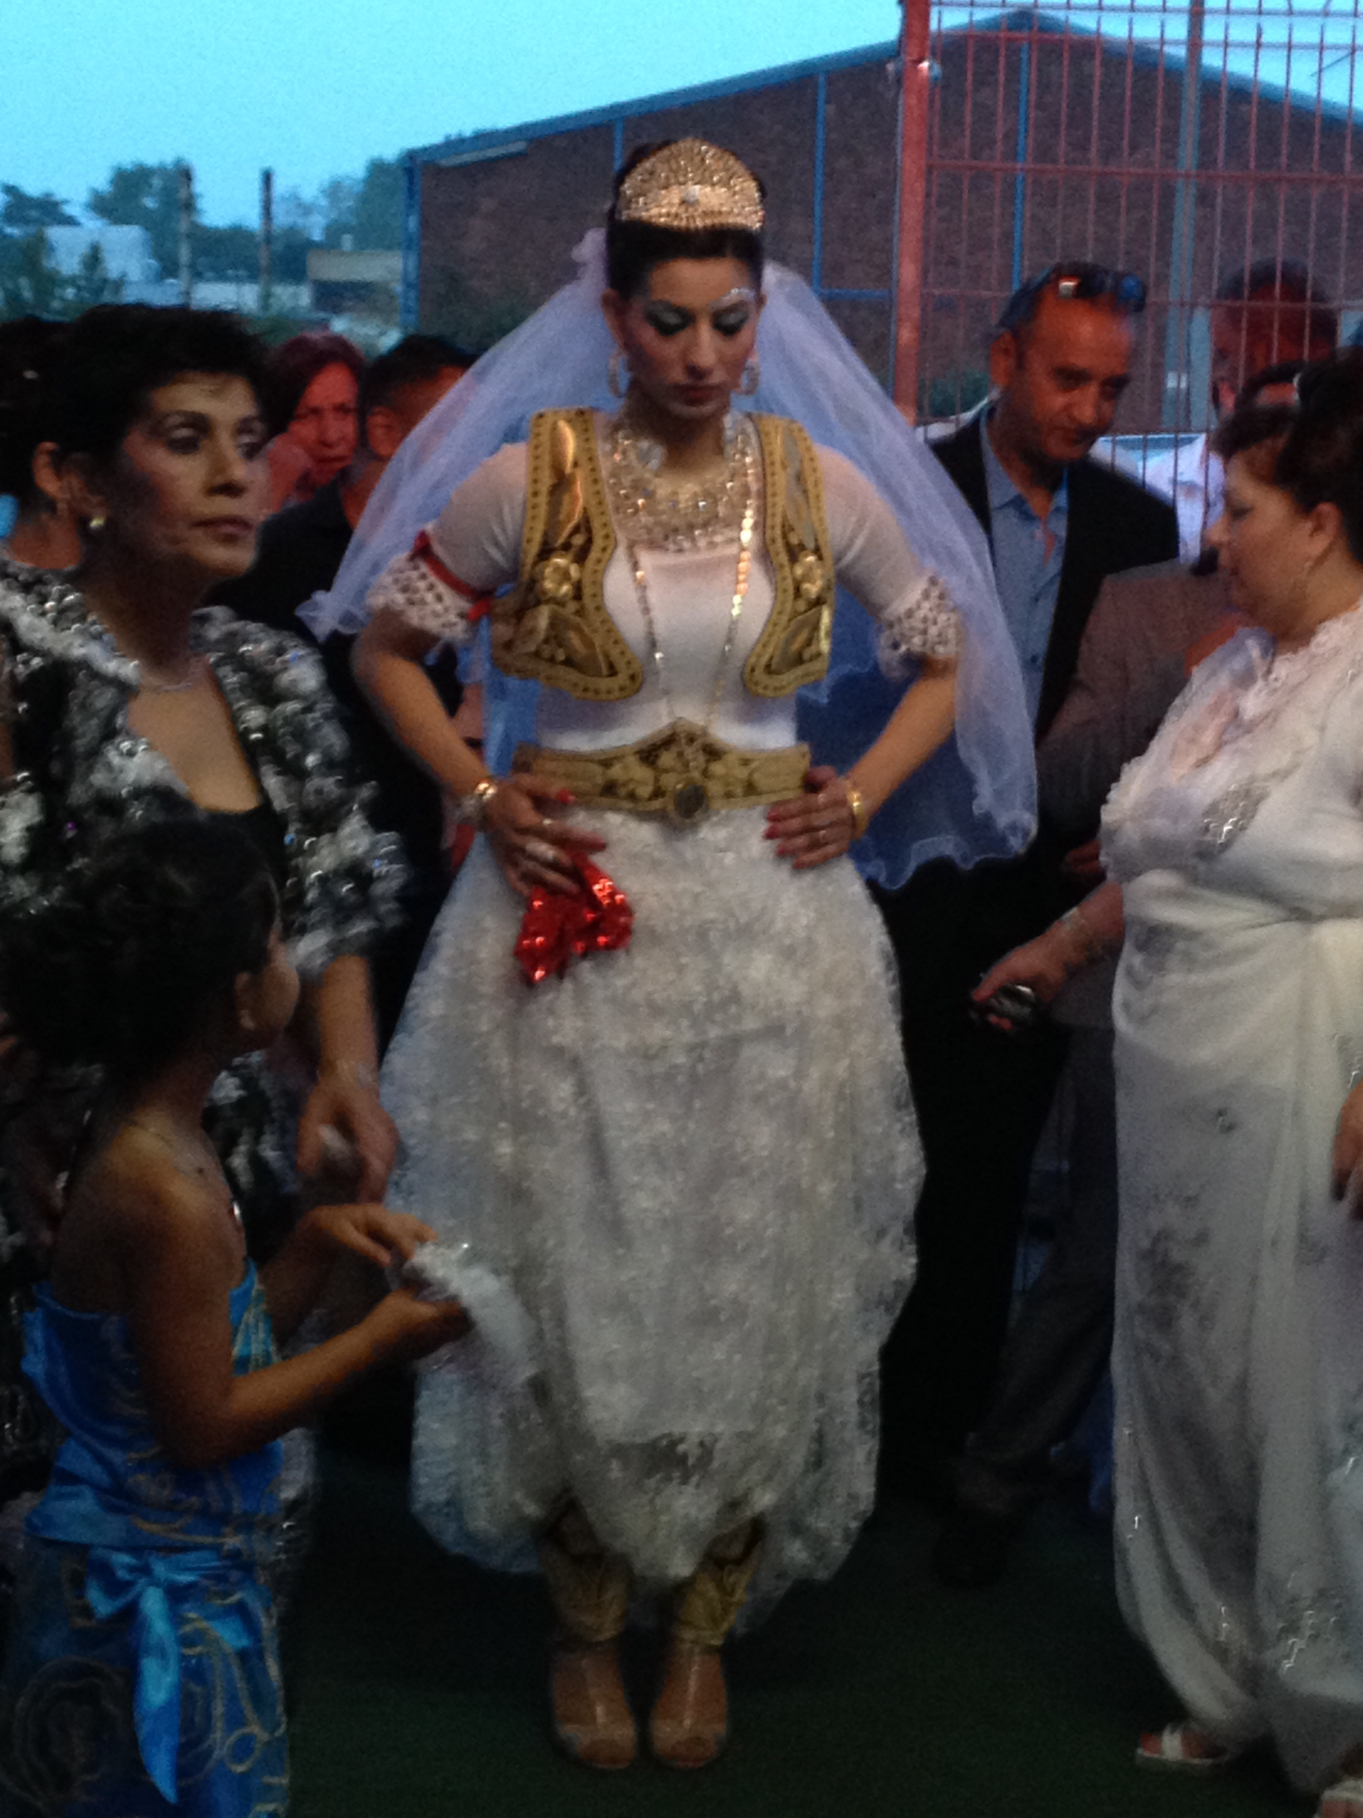
New bride enters banquet hall, Bremen, 2014

Slide 15
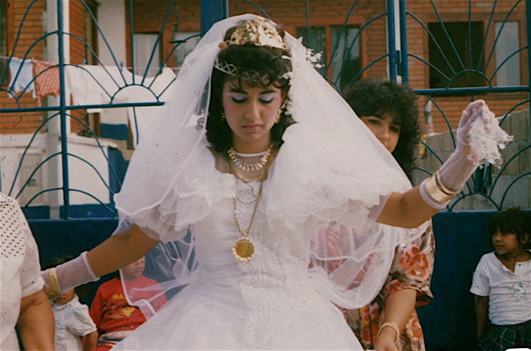
Temana

Slide 16
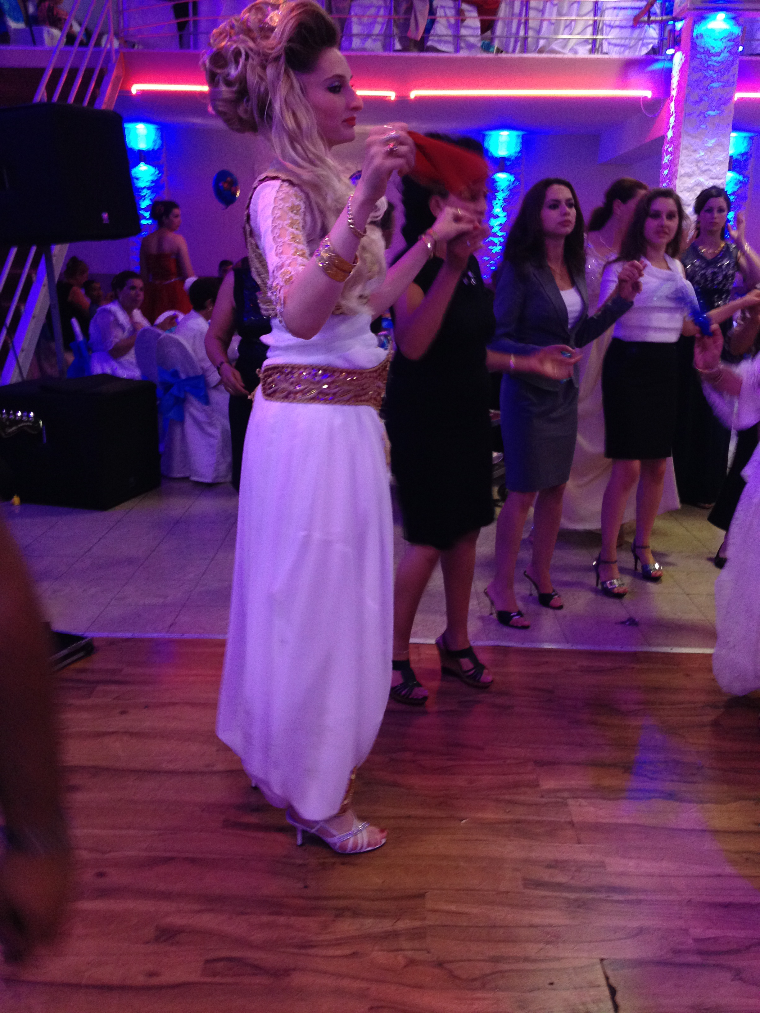
Bride from Podujevo; high brideprice

Slide 17
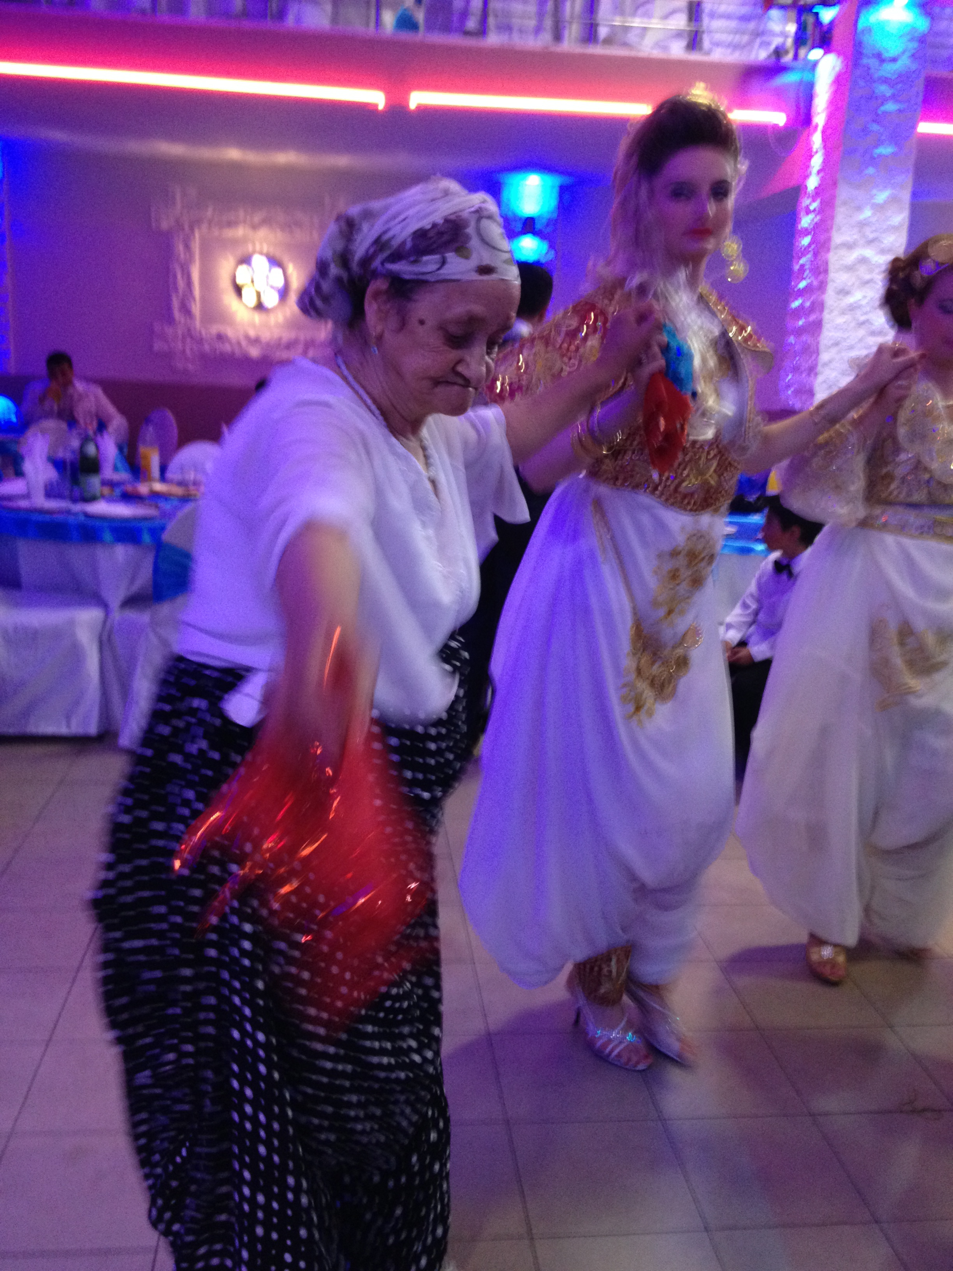
Respect for elders

Slide 18
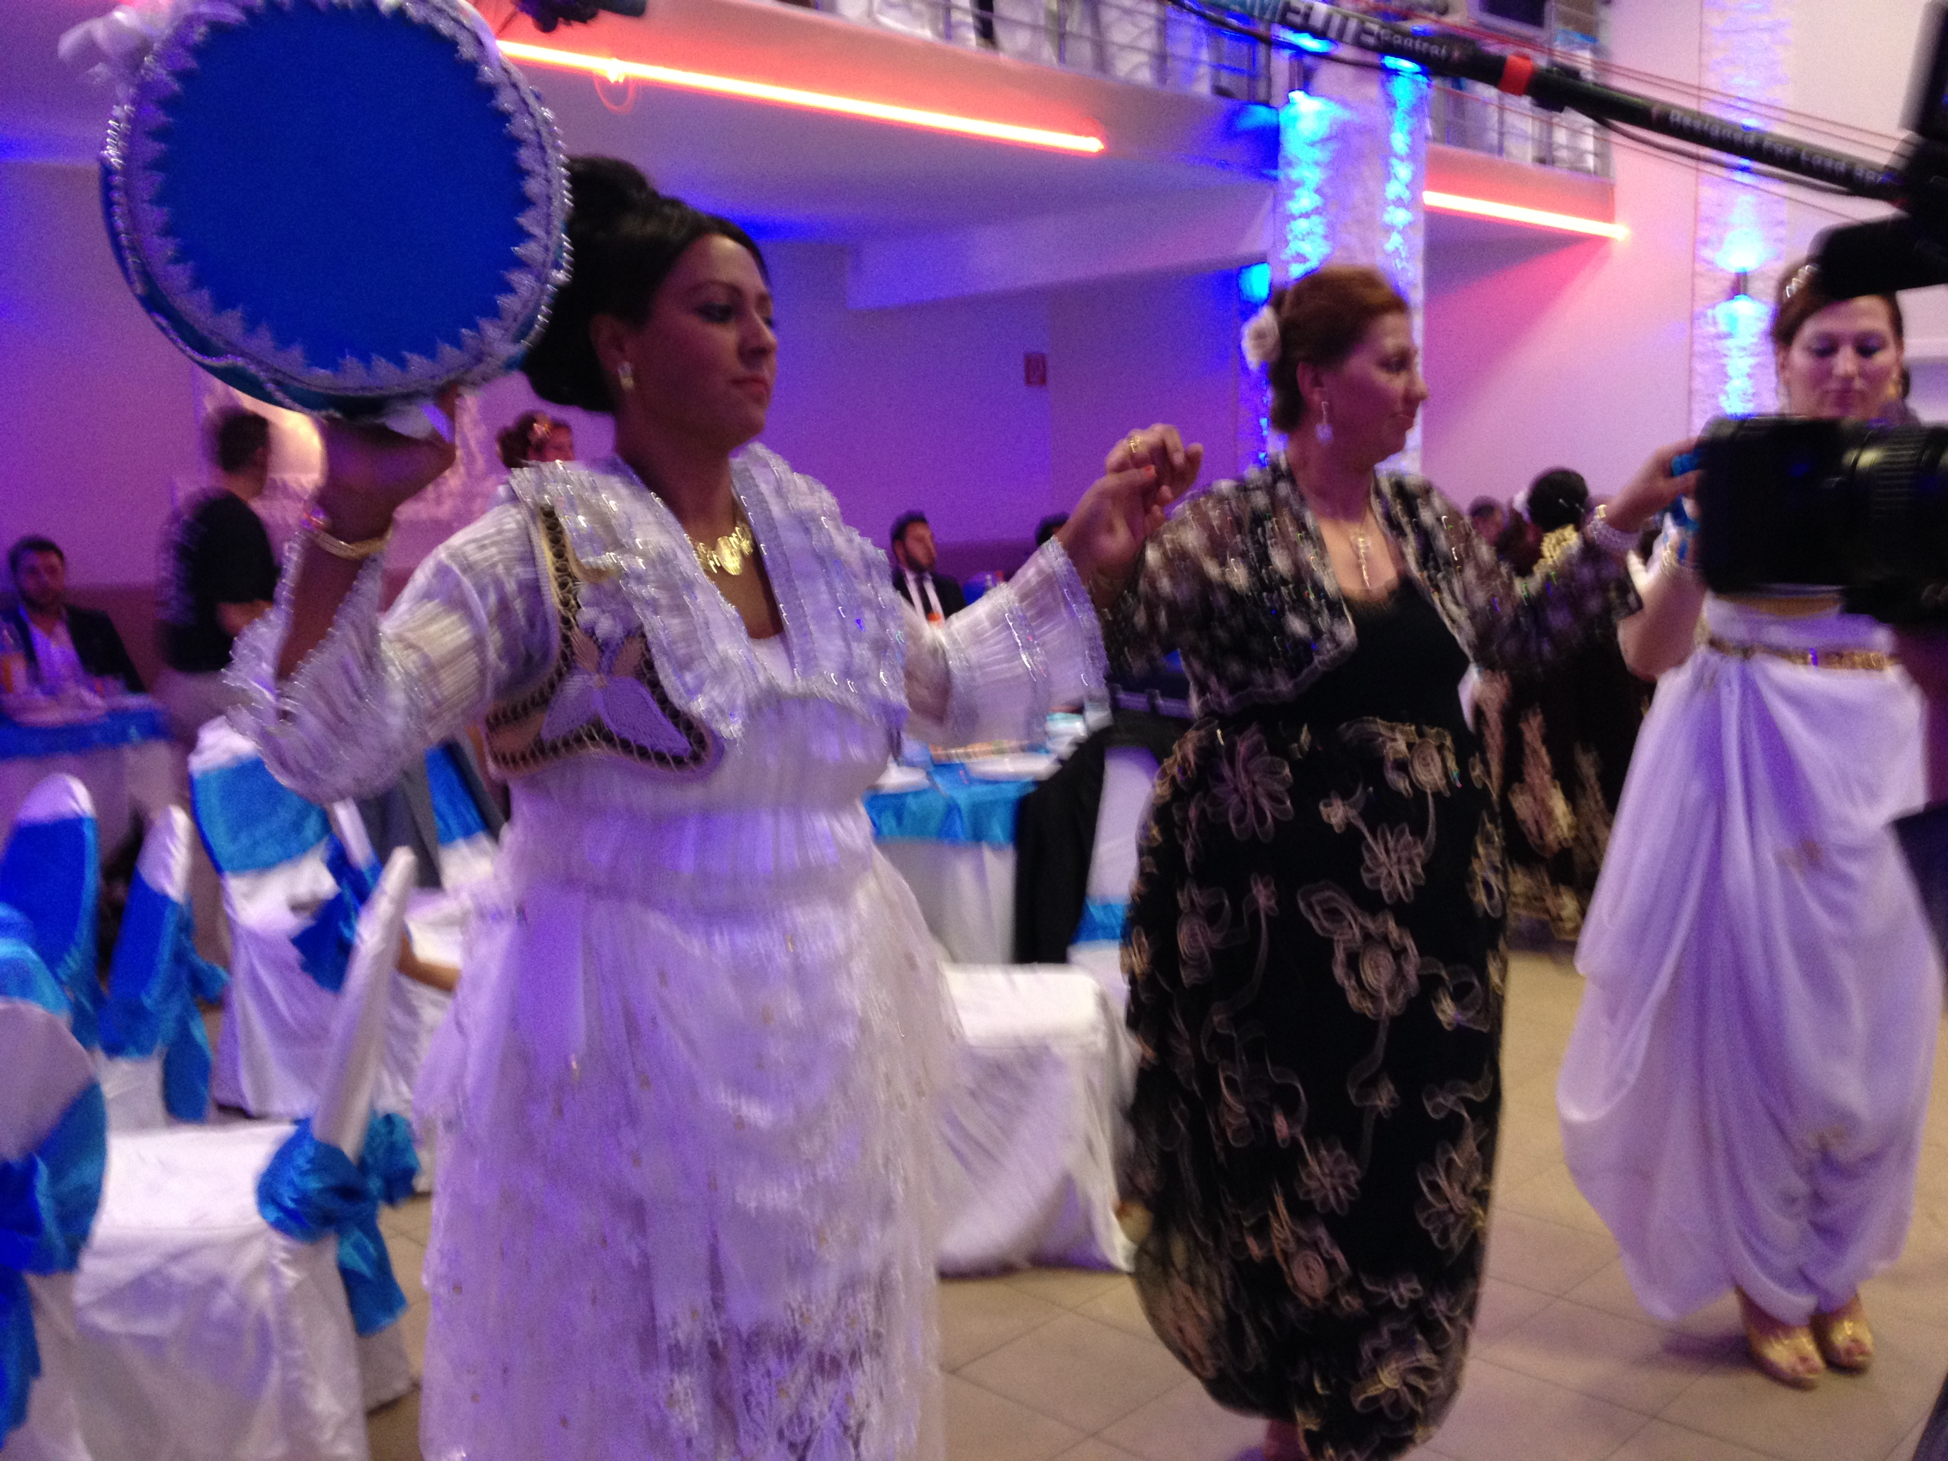
Women dancing with sieve

Slide 19
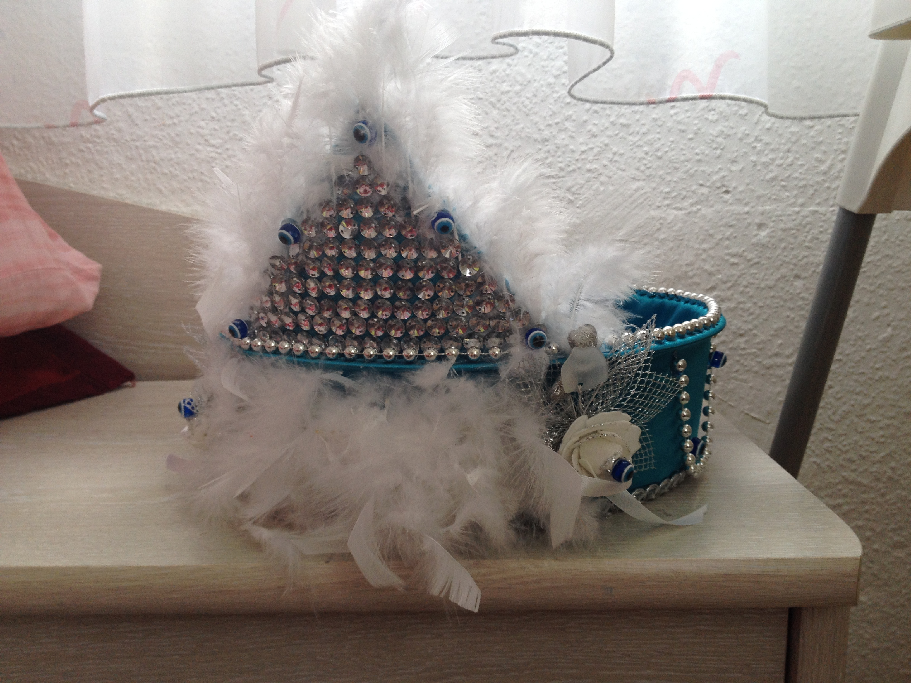
Decorated Sieve

