Slide 1
Balkan Romani Music and Dance
History
Politics, discrimination, and activism
Occupations
Contexts of music: kinship and family life
Gender
Ritual
Genres
Migration, transnational communities
Role of non-Romani performers
Appropriation

Slide 3
“gypsy”
Stereotypes: Romantic and Criminal
Representation
How do we know what we know about Roma?
Who gets to define “Gypsies”/Roma?

Slide 4
Esmeralda, Disney’s Hunchback of Notre Dame

Slide 5
Gypsy Crunch Cereal

Slide 9
Cultural Appropriation: Fashion, food, magic, music

Slide 10
TLC: April 2014 season

Slide 12
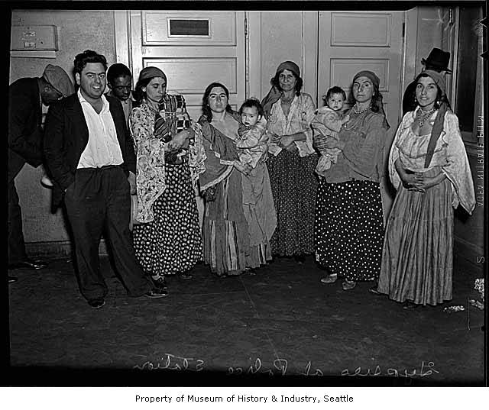

Slide 13
Romani “gypsies” arrested by Seattle police March 26, 1937 (Seattle Post- Intellingencer)
Though they hadn't violated any laws and three of the nine were just babies, this group of Romany were arrested for belonging to a traditionally nomadic ethnic group, then known as "gypsies." A detective explained that the arrest policy was a shortcut to preventing a lot of shoplifting, money "blessing, " and fortune-telling, crimes stereotypically associated with members of this ethnic group. Nowadays, this strategy of preemptive arrest could be considered racial profiling.

Slide 14
“The nation against gypsy terror and invasion” 2015

Slide 15
Feb. 16, 2019

Slide 16
Death to mangali (slur for Roma)

Slide 17
Demolitions, evictions, August 2020

Slide 18
EU Alliance of Conservatives, The Future of Europe: Traditionalism, Christian Values, Patriotism Bulgarian MP Angel Dzhambazki
Notes:
ICH discourse (safeguarding) evokes the cultural object in danger-- the threat of globalization; what is ours needs to be protected.
This resonates with nationalist parties and platforms that see native culture under attack-- EU as meddling, sees gender rights as foreign concept, see Muslims and Roma as foreign and dangerous terrorists.
Nationalist websites images feature women and children—family values--in costume— at E Orthodox religious sites—
Dangerous images of Roma, Muslims, refugees, trans people, gay people, prostitutes
Folk music is ours. But village music is too obsolete old fashioned, so turn to pop music and even wedding bands.
MV—imagining the past—neo-traditional turn—
BG: authoritarian and even mainstream parties
Benjamin Teitelbaums’ of Bannon by right wing.
Retro- marketing—selected nostalgia
We want our country back again
Let’s make our country great again, patriotism tied to cultural pride
Multiculturalism is over
Ethnos before demos – race and ethnicity before citizenship

Slide 19
Current protests and court case in Niš, South Serbia Re: Lack of electricity in a large Romani neighborhood

Slide 20
Justice Denied: Roma in the Criminal Justice System (Serbia and North Macedonia, 2021)
Provides clear evidence that
“Institutional racism is embedded in the criminal justice system …. Romani defendants face discrimination from police, judges, prosecutors, and often their own lawyers…. Pervasive and routine antigypsyism in state and society leads to racially-biased decisions and outcomes for Roma …. Romani defendants are faced with discriminatory attitudes and biases that skew outcomes against them, so that the very system that is meant to impart fair and equal justice is, in fact, doing the opposite”
European Roma Rights Center

Slide 21
Roma: largest minority in Europe
Lowest rates of education, political participation, and social integration
Inferior health care and housing
80-90% unemployment in some regions of Eastern Europe
Widespread prejudice among majority populations
Physical violence and intimidation

Slide 22
Roma
Terminology: Gypsy, Gitano (Egyptian),
Tsigani, Zigeuner, (atsinganoi)
Population: 12 million+ world wide
Largest concentration in Eastern Europe and Spain
1 million in US
Migration from East Europe to US 1880s-1920s
History: NW Indian origin, diaspora
Discrimination

Slide 25
Indian diaspora; linguistic evidence
Diversity of Romani sub-groups
Nomadism/sedentarism
Slavery in southern Romania 1300s- 1860s
Nazi period
Socialist assimilation measures
Forced sterilization of Romani women
Tracking of children into “special” schools
Gypsy “crime units” in US cities
Evictions, police violence
Structural discrimination
Rise of neo-facism
Open Society Foundation short animated history:
https://www.youtube.com/watch?v=Q6wSLfGBVGY

Slide 26
Paradox:
Roma revered for their arts (especially music)
yet reviled as people
Musicality is a positive stereotype
Sometimes promoted by Roma

Slide 27
Historical Occupations: Gendered
Professional music (instrumental- male), singing and dance
Animal training (bear and monkey trainers), circus work
Metal work, e.g., blacksmithing (US: car repair)
Horse sales and doctoring (US car/RV sales)
Wood working
Basketmaking
Fortune-telling
Middleman trading
Some professions depended on mobility

Slide 28
Romani wedding, Pazardhzik, Bulgaria, 1984

Slide 29
Gender: Women’s issues (true for Balkans in general)
Patriarchy; patrilocal residence
Yet female domestic and ritual power
Domestic obligations
Also employment: double burden
Education
Domestic violence
Ritual duties
Sexuality, virginity, arranged marriage
Homophobia

Slide 30
Romani wedding, Šutka, Macedonia, 1990

Slide 31
Romani wedding, Šutka, Macedonia

Slide 32
Romani bride, Šutka, Macedonia

Slide 33
Macedonian Romani wedding, New York, 1996 Order of the dance line expresses kinship ties

Slide 34
Blood-stained sheet in Macedonia, 1990

Slide 35
Double wedding, 1996

Slide 36
Virginity? Blaga Rakija (sweet brandy)

Slide 37
Wedding, 2018, Beograd, Serbia, 3-part video https://www.youtube.com/watch?v=5z8Je_YVGhc

Slide 38
International Roma Day, April 2011

